Slide 1


SXSW London
01/06/2026 – 06/06/2026: WHY IT MATTERS

Slide 2

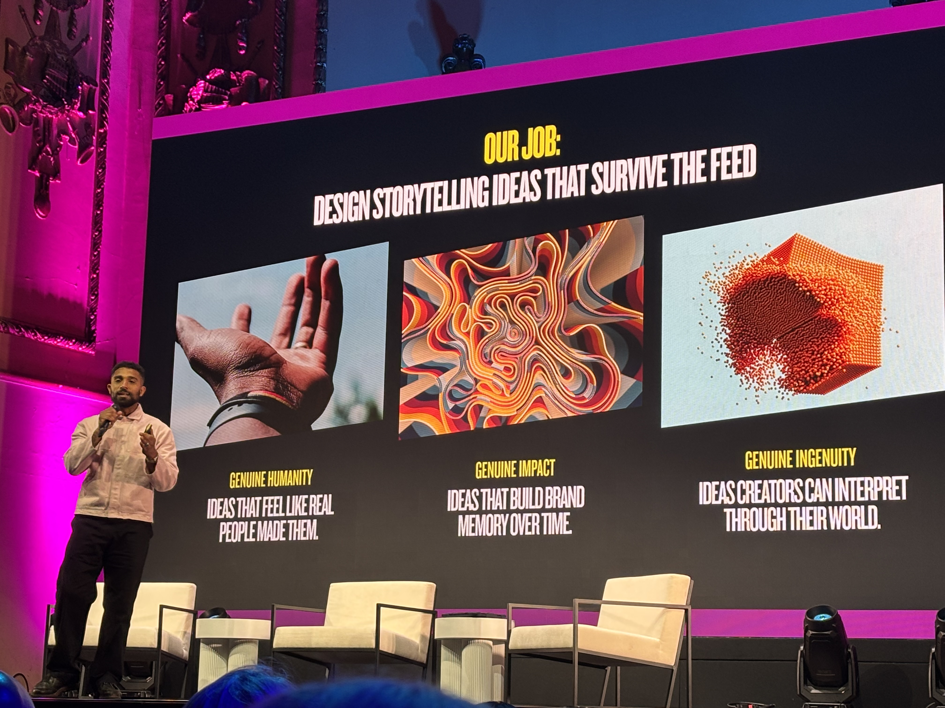
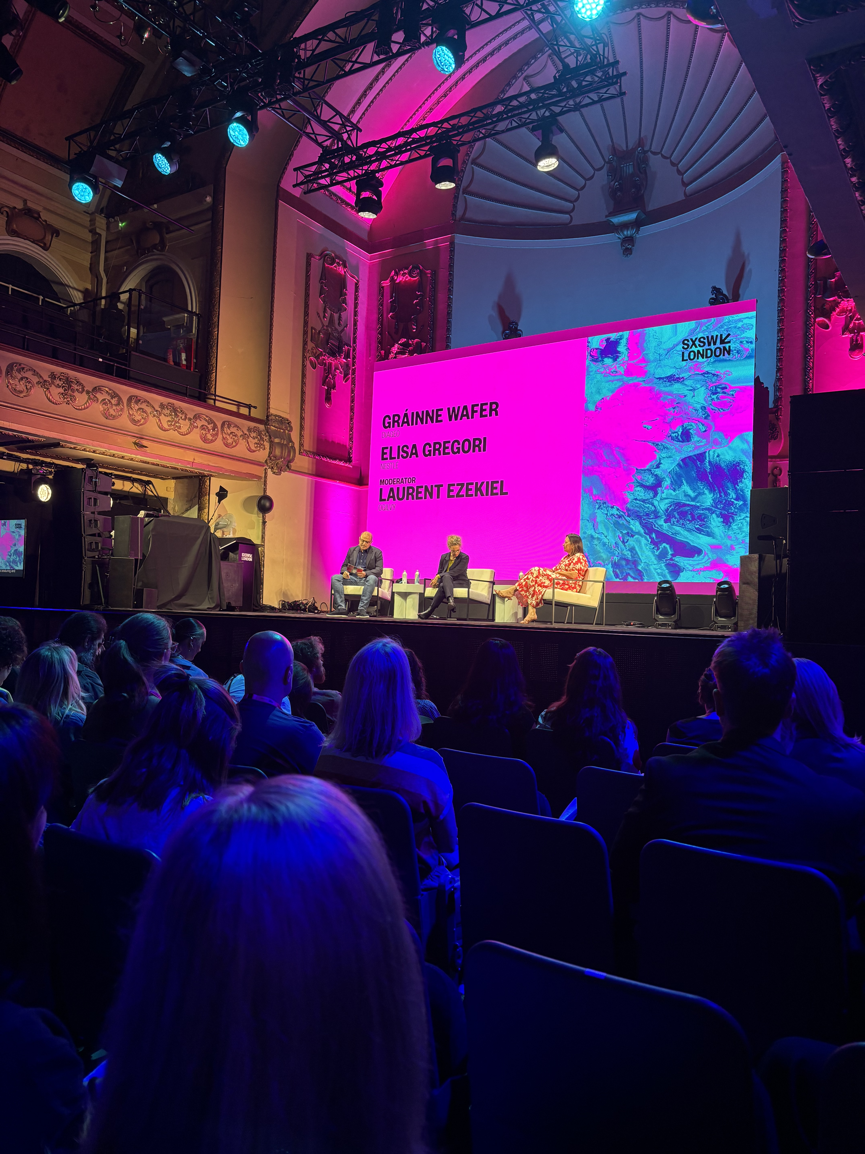
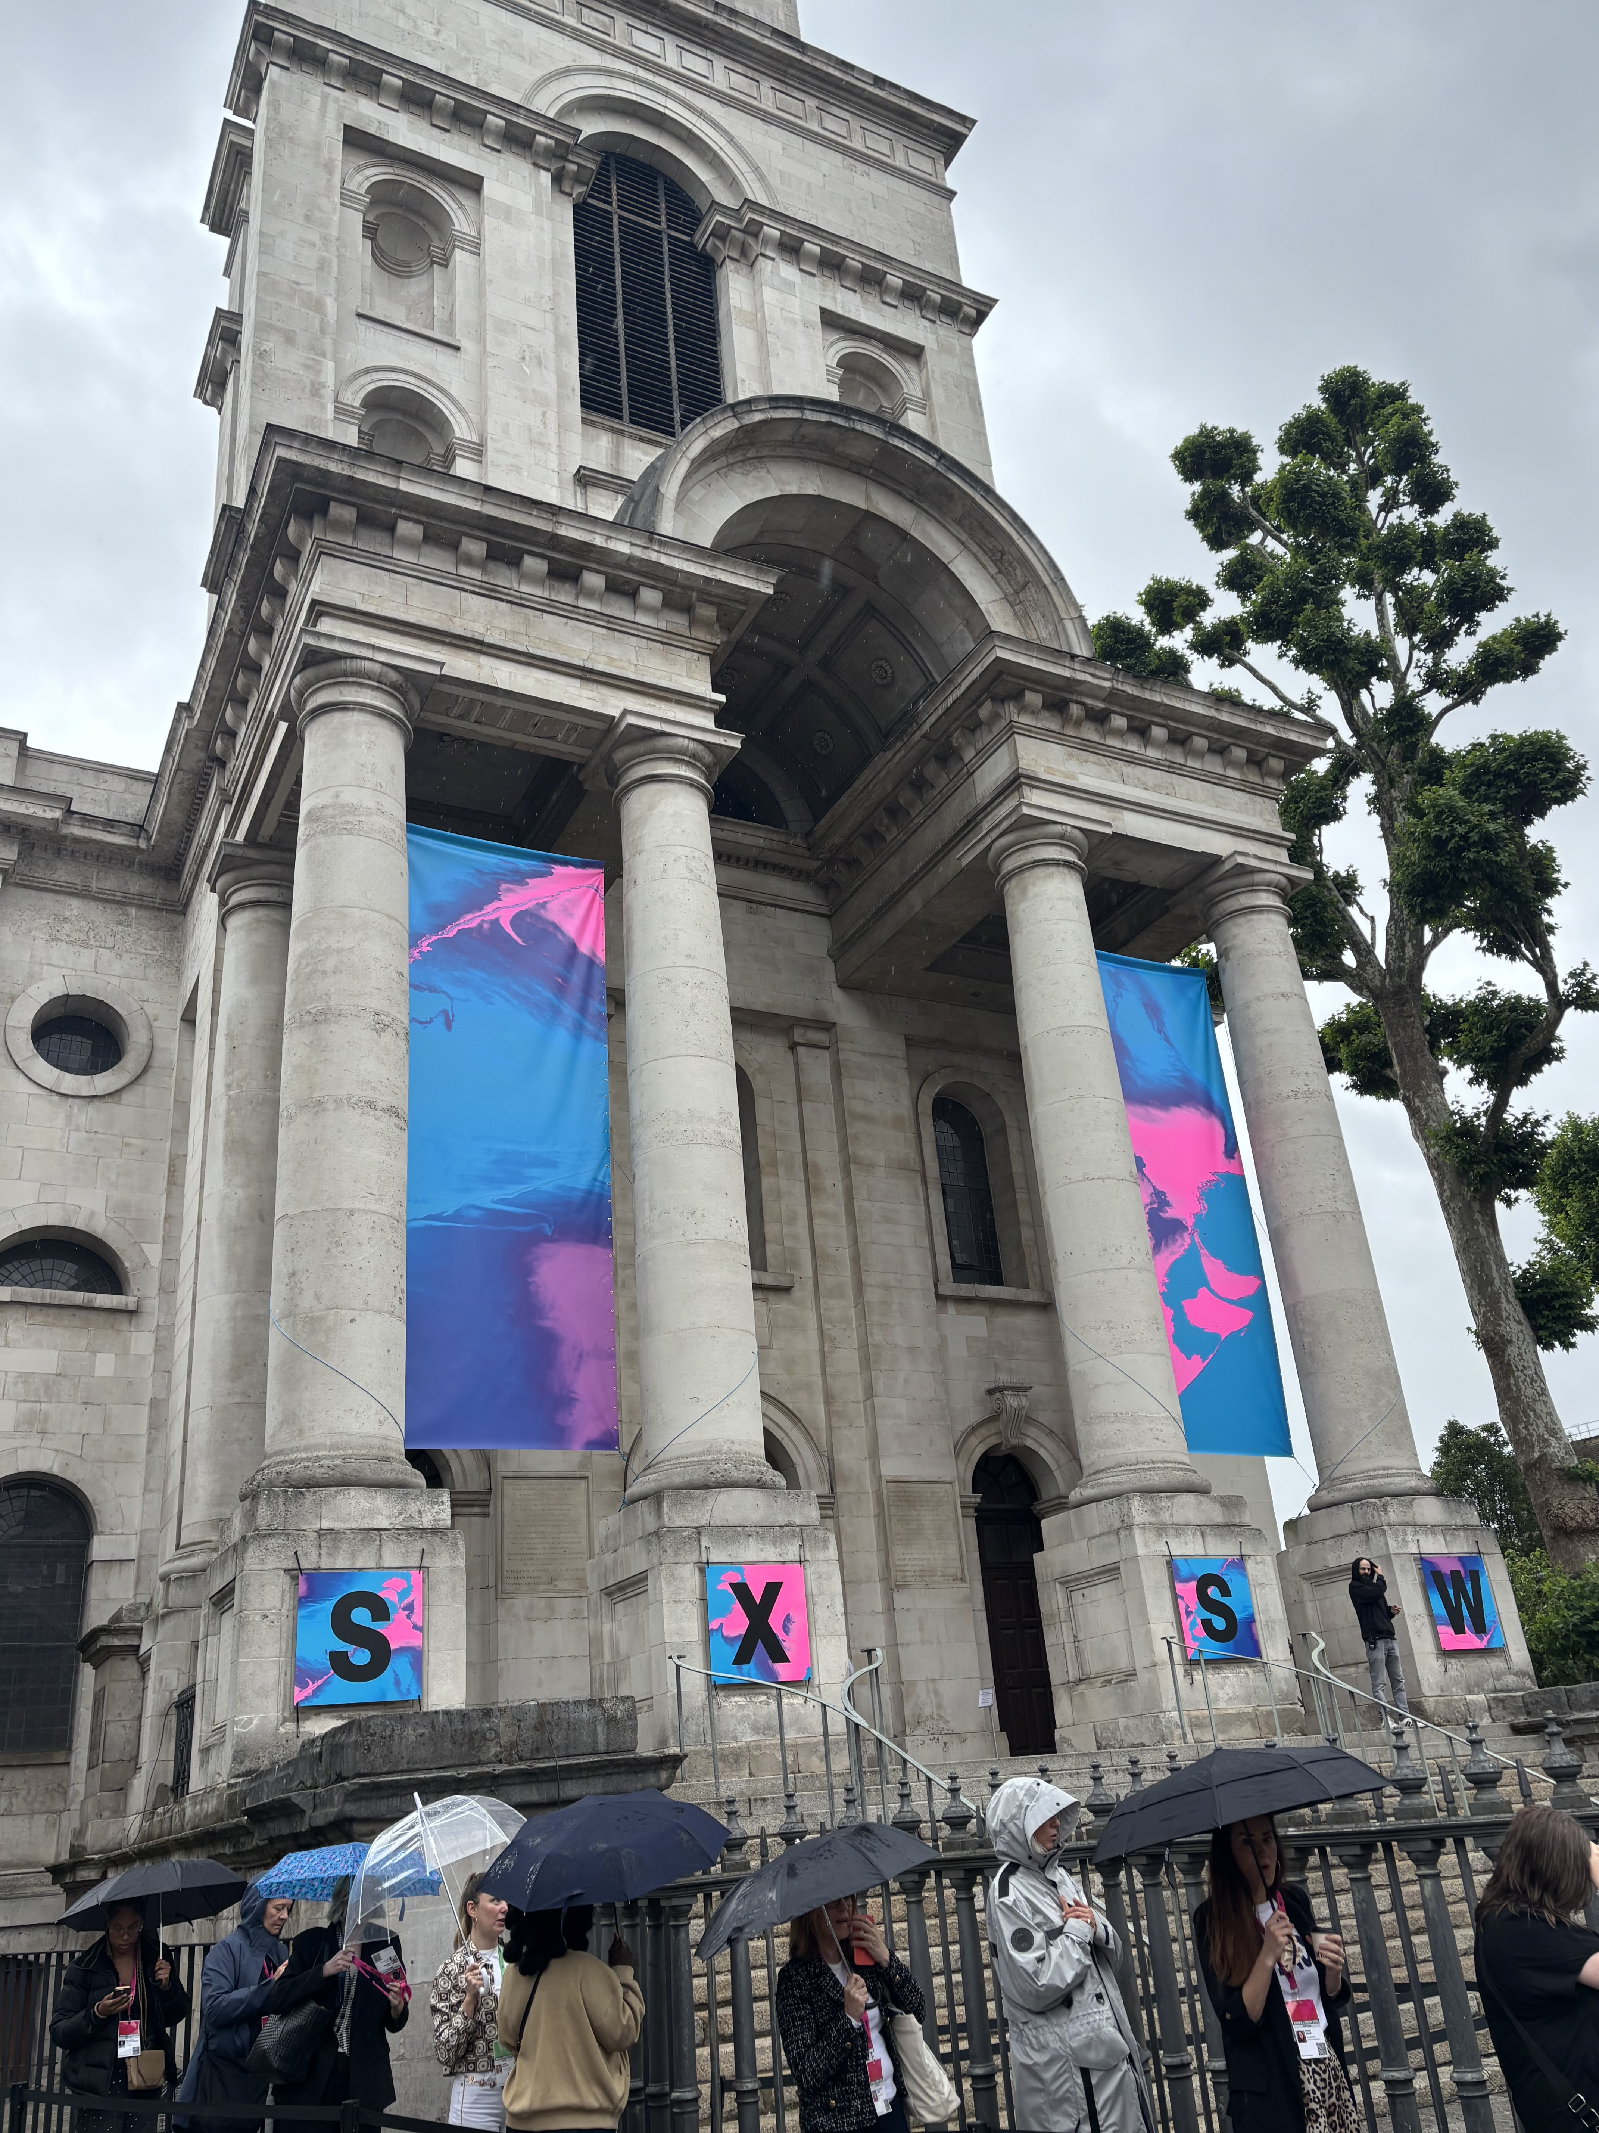
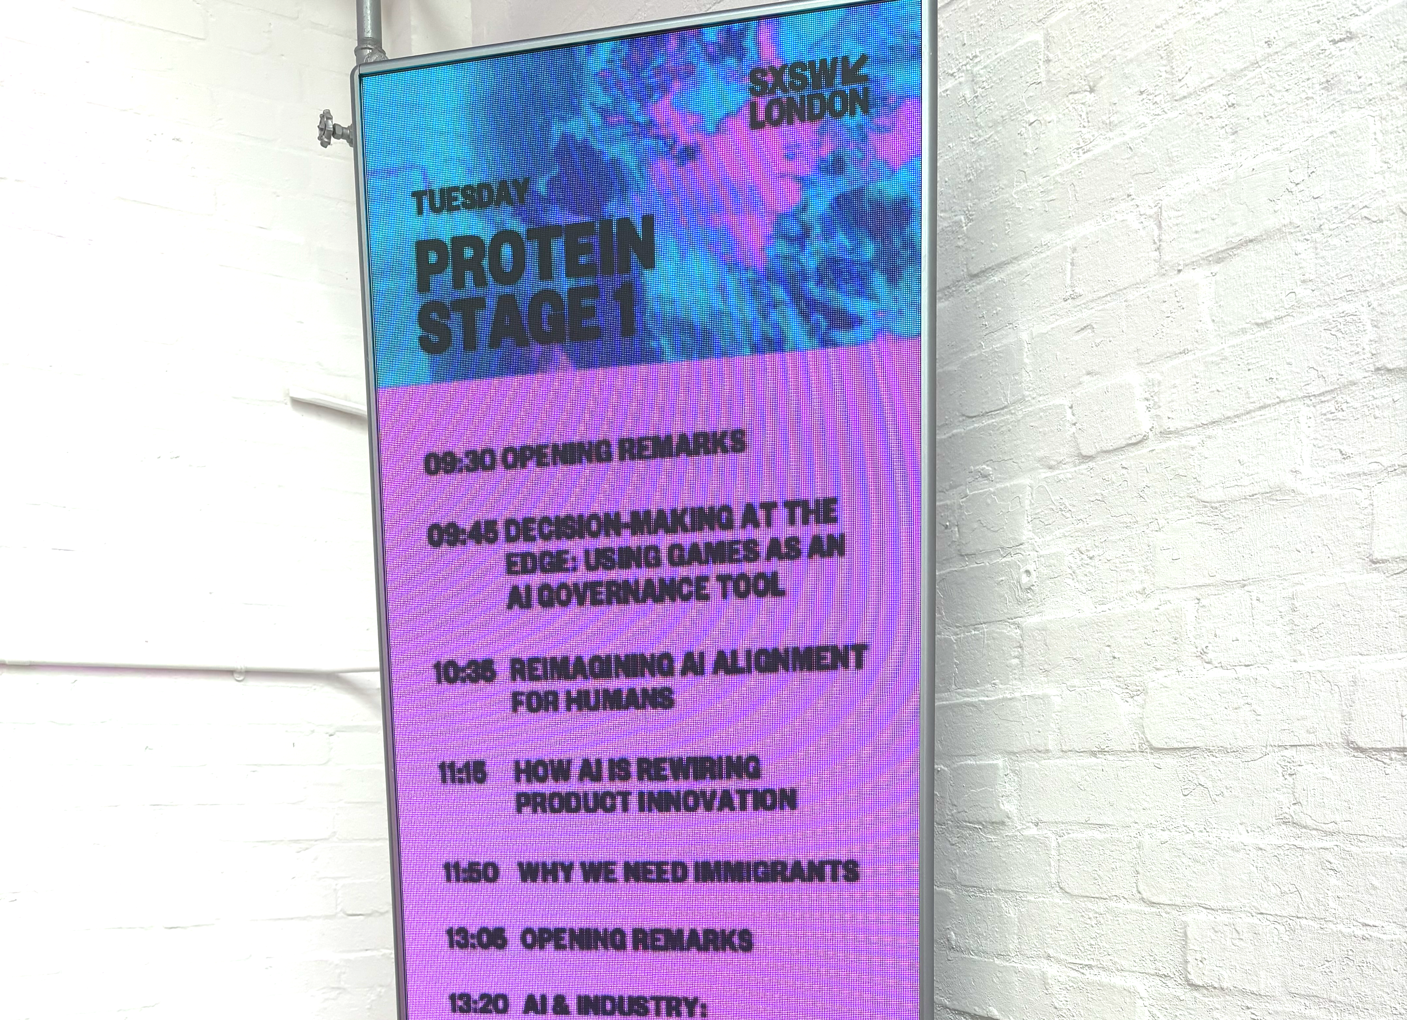
SXSW London brings together leaders from technology, business, culture, entertainment, media and innovation for six days of conversations, performances, screenings and networking across Shoreditch.
Unlike traditional industry conferences, SXSW is intentionally designed around convergence. The programme combines conference sessions, music, screen, startups, visual arts and brand experiences, creating opportunities for unexpected collisions between industries, disciplines and perspectives.
This year’s festival's programming spanned themes including AI and the future of human experience, the creator economy, marketing and advertising, innovation and transformation, frontier technologies, gaming, immersive worlds, design, fintech, health,tech and the future of cities.

Slide 3
For PrettyGreen, the most valuable takeaway from SXSW London 2026 was not any single speaker or session. It was the consistency of the themes emerging across completely different industries and disciplines.
Whether discussing AI, creator marketing, retail, entertainment, entrepreneurship or leadership, the same ideas repeatedly surfaced:
Community is becoming a greater source of competitive advantage than attention alone.
As AI accelerates, human qualities such as creativity, curiosity and judgement become more valuable.
Trust is increasingly a strategic asset.
Creativity is moving from a communications capability to a business capability.
Organisations that connect people, disciplines and ideas will outperform those operating in silos.
Innovation without responsibility is becoming harder to justify.
THE FOLLOWING REPORT SHARES OUR TAKEAWAYS FROM THE TALKS WE ATTENDED…

Slide 4
CONTENTS
SESSION 1: BUILDING ARTISTIC UNIVERSES WITHOUT BORDERS
SESSION 2:ATTENTION IS THE PRODUCT
SESSION 3:OVERLOADED WITH RUBY WAX
SESSION 4:MIKE SKINNER AND RORY SUTHERLAND IN CONVERSATION
SESSION 5:THE MEMENTO GENERATION, HOW TO CREATE VALUE WITH A NEW GENERATION OF SHOPPERS
SESSION 6: WHY CREATIVITY WILL SHAPE THE FUTURE OF BUSINESS
SESSION 7: FREEING BEN & JERRY'S - WHY OWNERSHIP MATTERS
SESSION 8:CREATE LIKE A CREATOR: HOW CONTENT PRODUCTION IS CHANGING
SESSION 9:WHAT HAPPENED TO GRASSROOTS CREATIVITY?
SESSION 10:BOSH: A CREATOR TAKEAWAY WITH BIG JOHN
SESSION 11: SCALING YOUR SOCIALS & PERSONA BRAND
SESSION 12: CAN WE STILL SAVE THE INTERNET FOR KIDS?
SESSION 13: WHY WE NEED IMMIGRANTS
SESSION 14: HUMAN AI STRATEGY: FROM ADOPTION TO ORGANISATIONAL ADVANTAGE
SESSION 15: THE COMPANY YOU PITCHED ISNT THE COMPANY THAT THRIVES
SESSION 16: STAY LOUD, STAY WELL
SESSION 17: BEYOND PODCASTING: BUILDING SHOWS PEOPLE BELONG TO
SESSION 18: BEYOND PODCASTING: HEALING ARTS / ART AS CURE?

Slide 5

SESSION No.1
BUILDING ARTISTIC UNIVERSES WITHOUT BORDERS (MARVEL & FORTNITE)
Anthony Russo (AGBO, Marvel) , Joe Russo (AGBO, Marvel)
& Donald Mustard (AGBO, ex-Epic Games) in conversation

Slide 6

The discussion featured Joe and Anthony Russo, Donald Mustard, and Variety's Ramin Seto. The speakers explored the evolution of storytelling, highlighting AGBO's role in integrating film, video games, and technology.
They discussed the impact of Gen Z on storytelling, and the diversification of media consumption. The Russo brothers shared insights on their return to Marvel for "Doomsday," emphasizing collaboration and innovation.
Donald Mustard discussed the synergy between Fortnite and Marvel, and the importance of experimentation in storytelling across platforms.
Session 1 Building artistic universes without borders

Slide 7
KEY LEARNINGS:
FOLLOW A CLEAR CREATIVE ETHOS, NOT EVERY MICR0- TREND
Taste is fragmenting: Because everyone is connected via phones and social platforms, audiences self-organize into micro-communities with specific interests.
Marketing takeaway: Don’t try to speak to everyone at once. Define a clear, specific ethos (tone, values, POV) and build consistently for the community that truly cares.
CO‑CREATE WITH COMMUNITIES, DON’T JUST BROADCAST AT THEM
“Obsession / Backrooms” grew from a community myth on the internet, then became a film everyone in that community had to see.
Fortnite × Marvel (Thanos in Fortnite) worked because it met fans inside the world they already loved.
Marketing takeaway:
Look for stories, memes, and myths already forming in your audience.
Partner with those narratives and platforms (games, TikTok, fandom spaces) instead of forcing a totally top‑down campaign.
Session 1 Building artistic universes without borders

Slide 8
KEY LEARNINGS:
THINK PLATFORM‑AGNOSTIC: STORY FIRST, CHANNEL SECOND
They refuse to rank cinema vs. streaming vs. phone vs. game: each story has a natural home.
Marketing takeaway:
Ask: “Where does this story feel most native?” (short‑form social, live event, game integration, long‑form video, newsletter, etc.).
Design different expressions of the same core story per channel, instead of copy‑pasting one asset everywhere.
DESIGN FOR PARTICIPATION,
NOT JUST VIEWS
Fortnite events let tens of millions experience a story together in real time.
Their film thinking + game thinking = worlds people enter and affect, not just watch.
Marketing takeaway:
Shift from “campaigns to be watched” to experiences to be joined:
Live digital moments, in‑game drops, interactive storylines, UGC challenges, real‑time reveals.
Session 1 Building artistic universes without borders

Slide 9
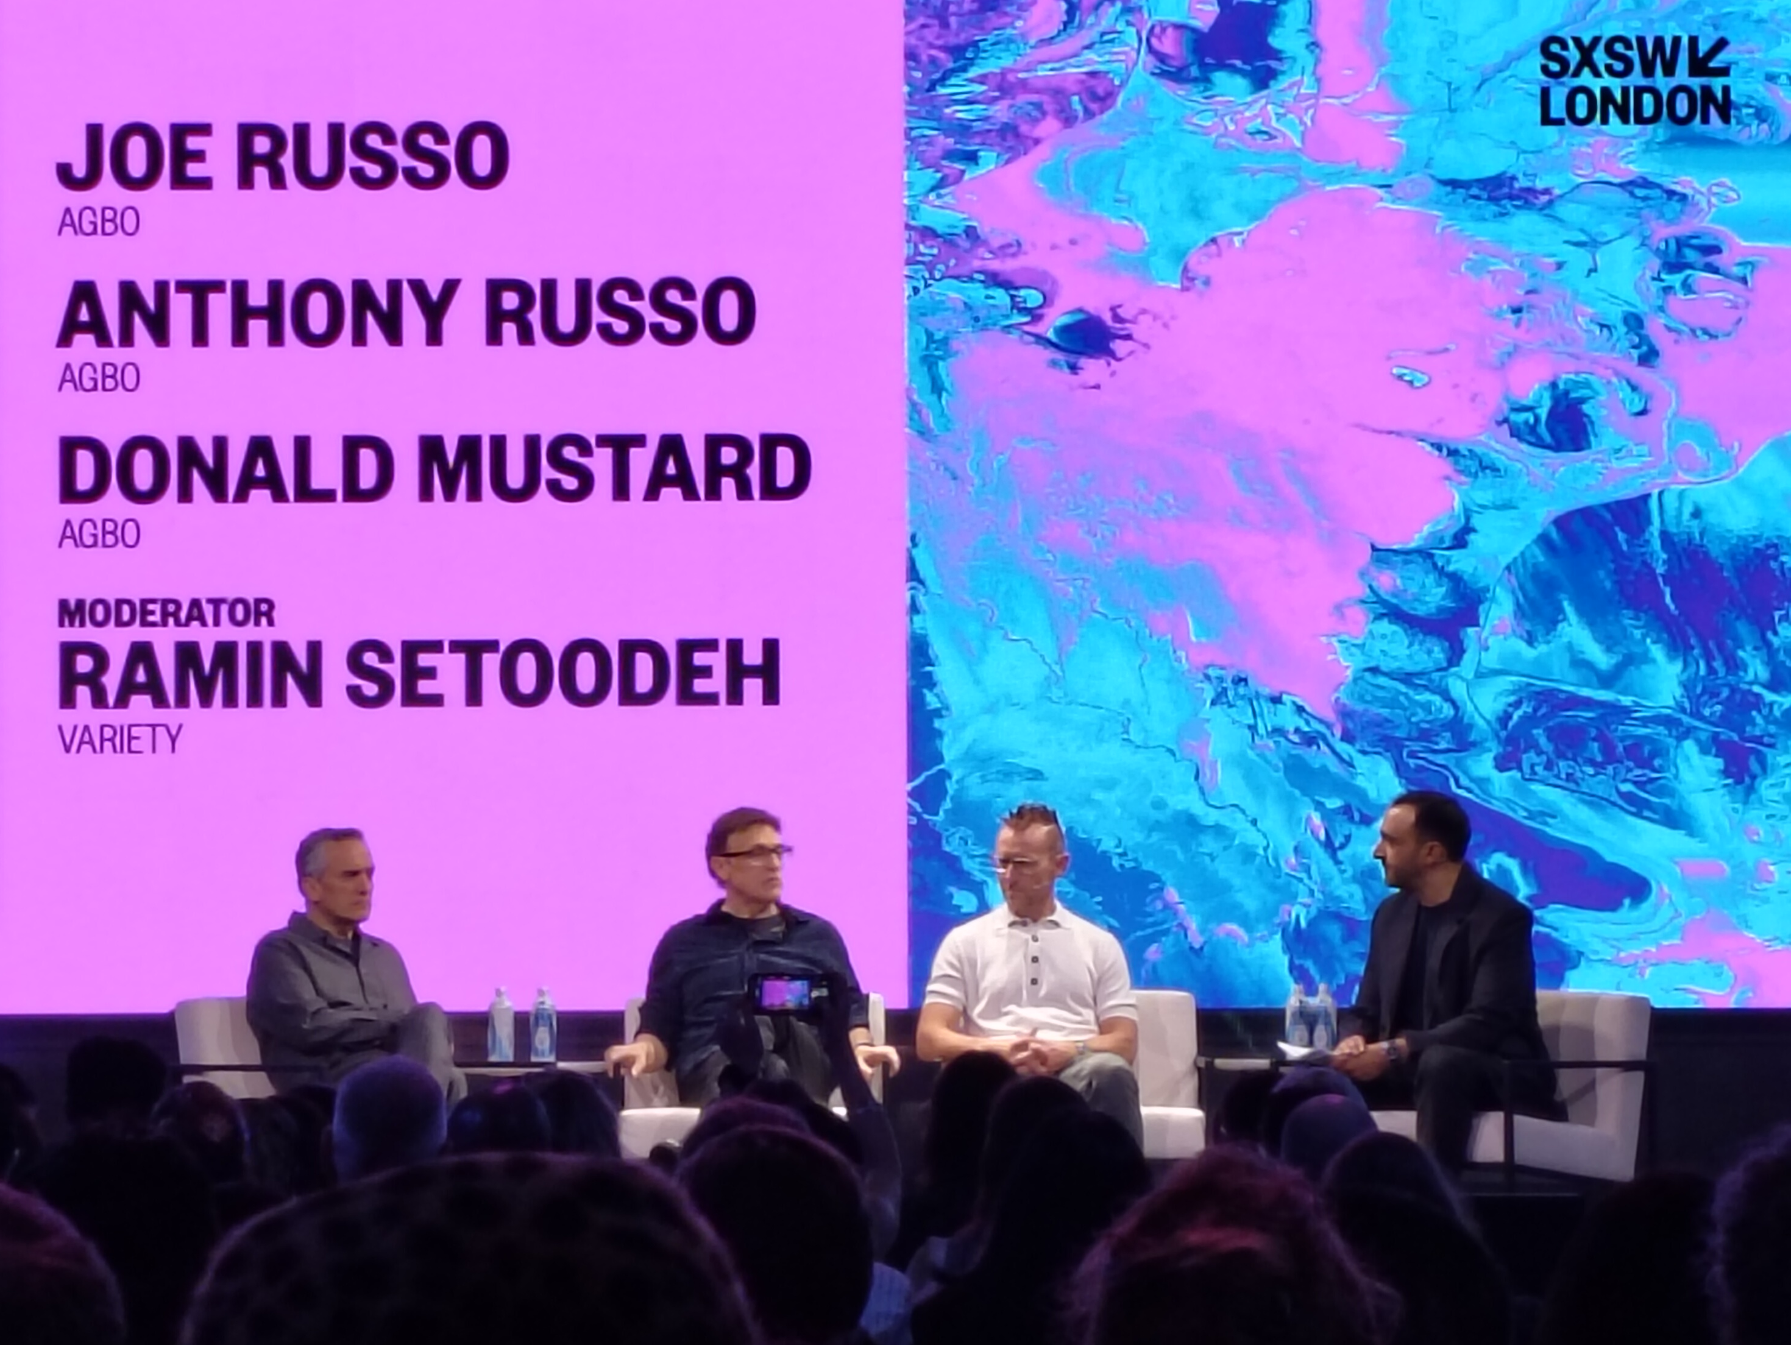
KEY LEARNINGS:
SURPRISE A HYPER‑LITERATE AUDIENCE
Gen Z grew up consuming massive amounts of media across formats
Effectively have a “PhD in storytelling” just from exposure and will reshape what kinds of stories are made and how they are told
Marketing takeaway:
Your audience has seen every marketing trope. Build in:
Structural surprises (unexpected formats, partnerships, or POVs)
Narrative twists (challenging your own brand clichés, playful self‑awareness).
Session 1 Building artistic universes without borders

Slide 10
SESSION No.2
ATTENTION IS THE PRODUCT
Featuring Ryan Serhant - CEO Serhant (Owning Manhattan, Million Dollar Listing New York)

Slide 11
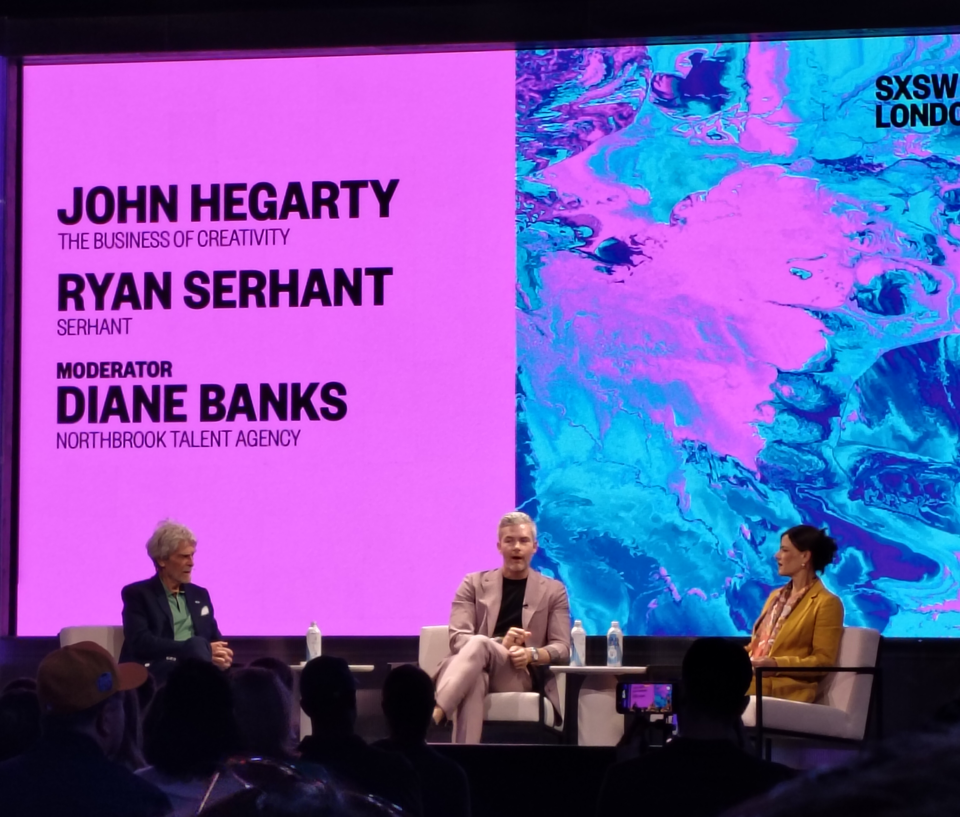
A high-energy conversation about how attention is created, captured, and monetised today, from iconic advertising campaigns to TikTok, YouTube, and personal brands.
Session 2 Attention is the product

Slide 12
KEY LEARNINGS:
ATTENTION ISN’T THE PRODUCT ANYMORE - COMMUNITY IS
Attention is just the “hey, look over here.” The real product is a loyal community aligned around a shared purpose.
TRUST IS BUILT ON HOW YOU HANDLE MISTAKES, NOT HOW YOU SHOW OFF WINS
Admit, recover, and endure through failures - that’s what makes people relate to you and stick around.
DISTRIBUTION BEATS CONTENT… UNLESS YOUR IDEAS ARE DULL.
Great content is the car, but distribution is the fuel. Still, without a sharp, emotionally resonant idea, no amount of fuel matters.
MODERN BRANDS ARE MOVEMENTS,
NOT JUST LOGOS
The strongest brands sell belief and purpose, not just products. They behave more like communities or even religions than old-school “brands.”
YOU’RE NOT SELLING DATA; YOU’RE SOLVING EMOTIONAL PROBLEMS
Specs and features don’t move people. Stories that solve real fears (loneliness, status, belonging, time) do.
Session 2 Attention is the product

Slide 13
SESSION No.3
OVERLOADED WITH RUBY WAX

Slide 14
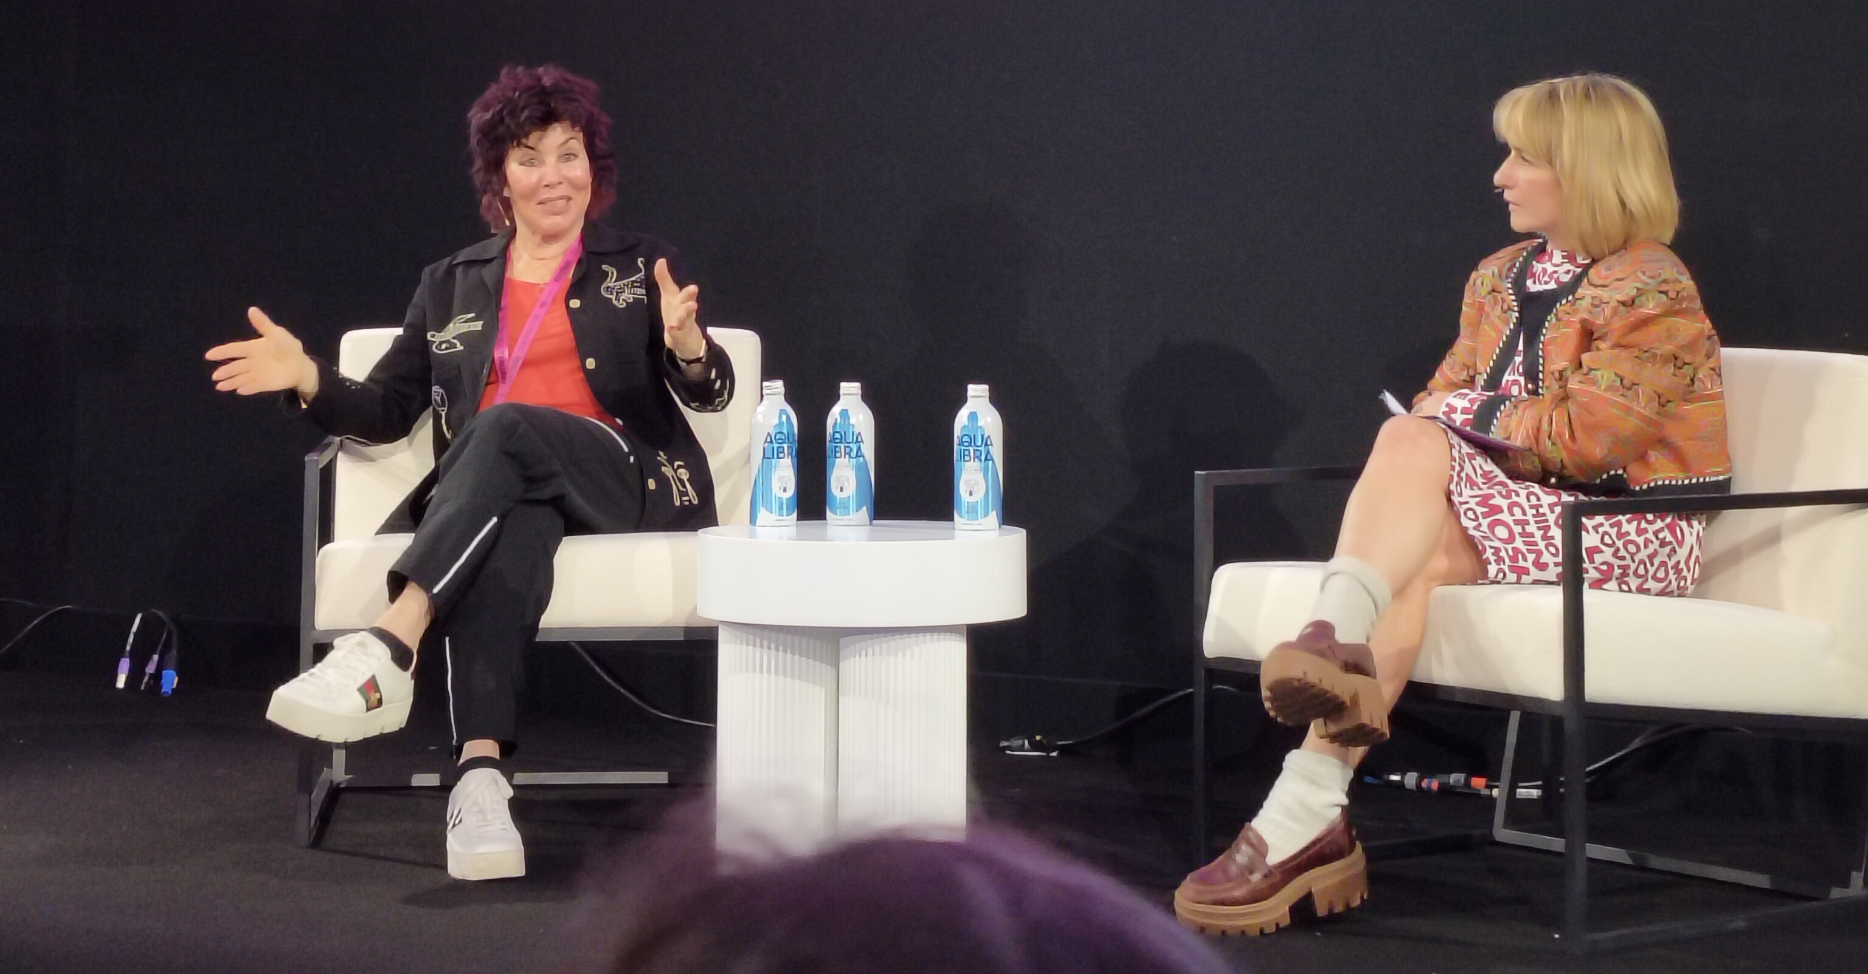
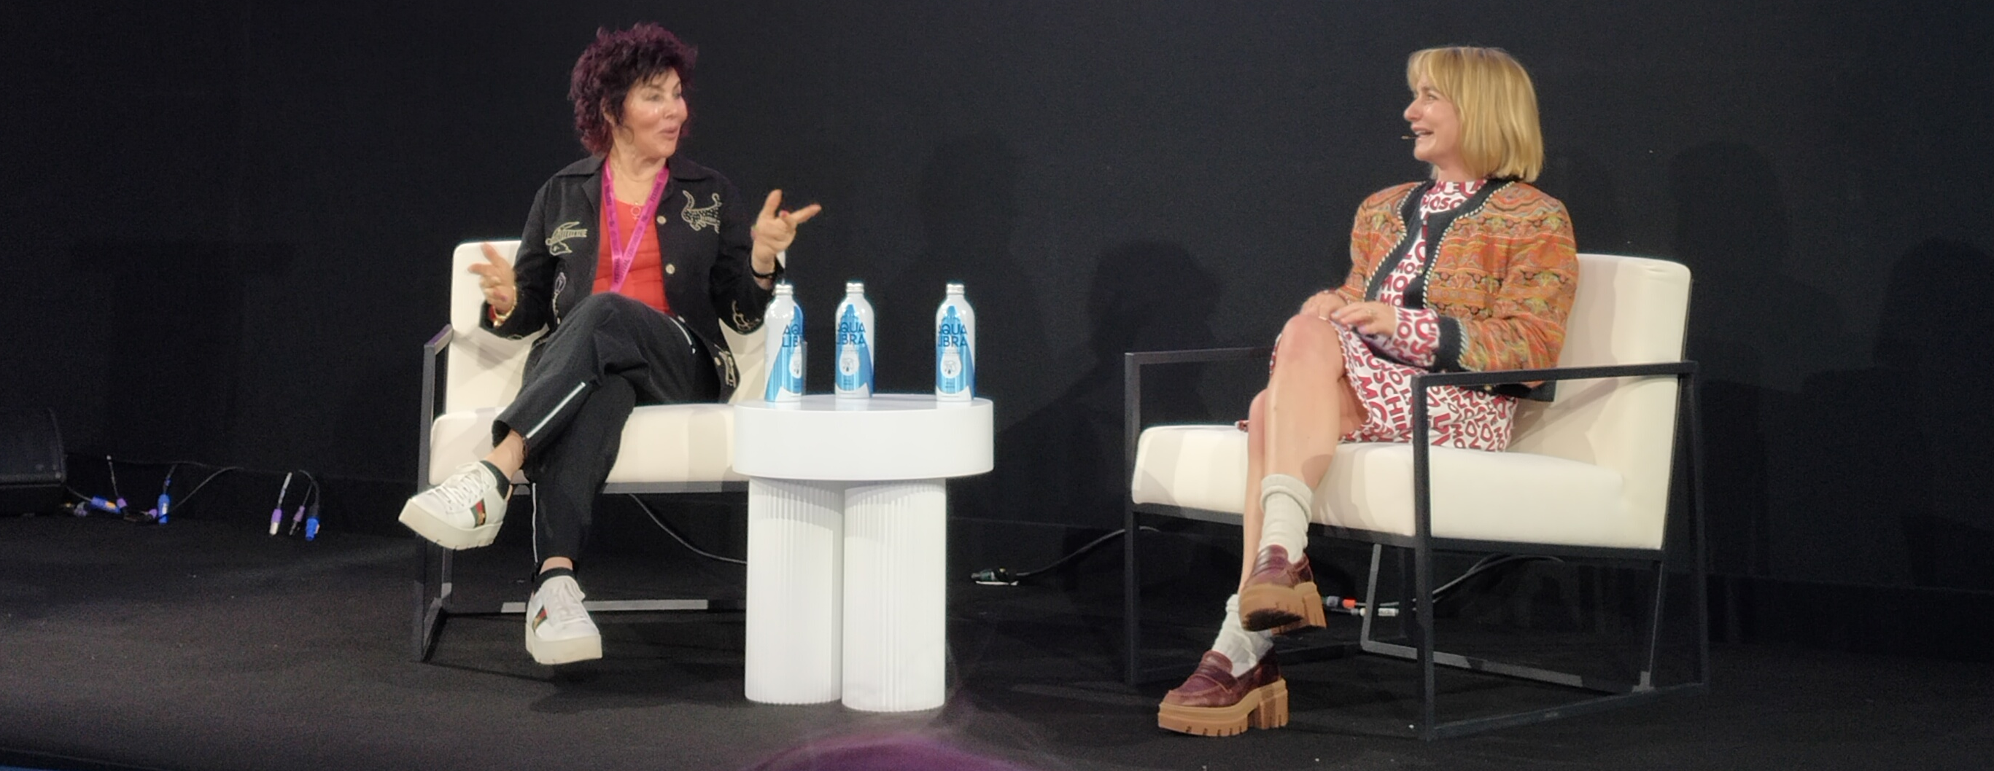
Ruby Wax, a comedian and mental health advocate, discussed her experiences and insights on modern life's distractions and mental health. She shared her strategies for managing stress, including her 30-day silent retreat where she meditated for 12 hours daily, and her Frazzled Cafe initiative for people to share their emotional states.
Wax emphasized the importance of mindfulness, neuroplasticity, and the need to train the brain like a muscle. She also reflected on her time in "I'm a Celebrity," highlighting the humanizing impact of removing masks.
Wax concluded by discussing the impact of social media and the wellness industry, advocating for mental health and community support.
Session 3 Overload with Ruby Wax

Slide 15
KEY LEARNINGS:
CURIOSITY CUTS THROUGH MASKS
Get under people’s personas fast – drop the flattery, be real, and they’ll drop their guard and be real back.
WE’RE NOT JUST STRESSED, WE’RE “FRAZZLED”
The real killer isn’t stress itself, it’s stress about stress plus constant comparison and performance (especially via social media).
COMMUNITY AND HONESTY BEAT PERFECTION
Spaces like Frazzled Cafe work because people show their “weather inside,” not a polished image. Feeling heard in a tribe defuses pressure.
THE BRAIN IS A GYM, NOT A SPA
Mindfulness isn’t incense and vibes; it’s reps. Consistent practice rewires the brain to cool cortisol, boost focus & steady you under pressure.
FIX YOUR MIND TO FACE A MAD WORLD
Whether it’s AI, fame, or the wellness rat race, Ruby’s stance is: pick your battles, regulate your own mind first, then go try to save the world.
Session 3 Overload with Ruby Wax

Slide 16
SESSION No.4
MIKE SKINNER AND RORY SUTHERLAND IN CONVERSATION

Slide 17
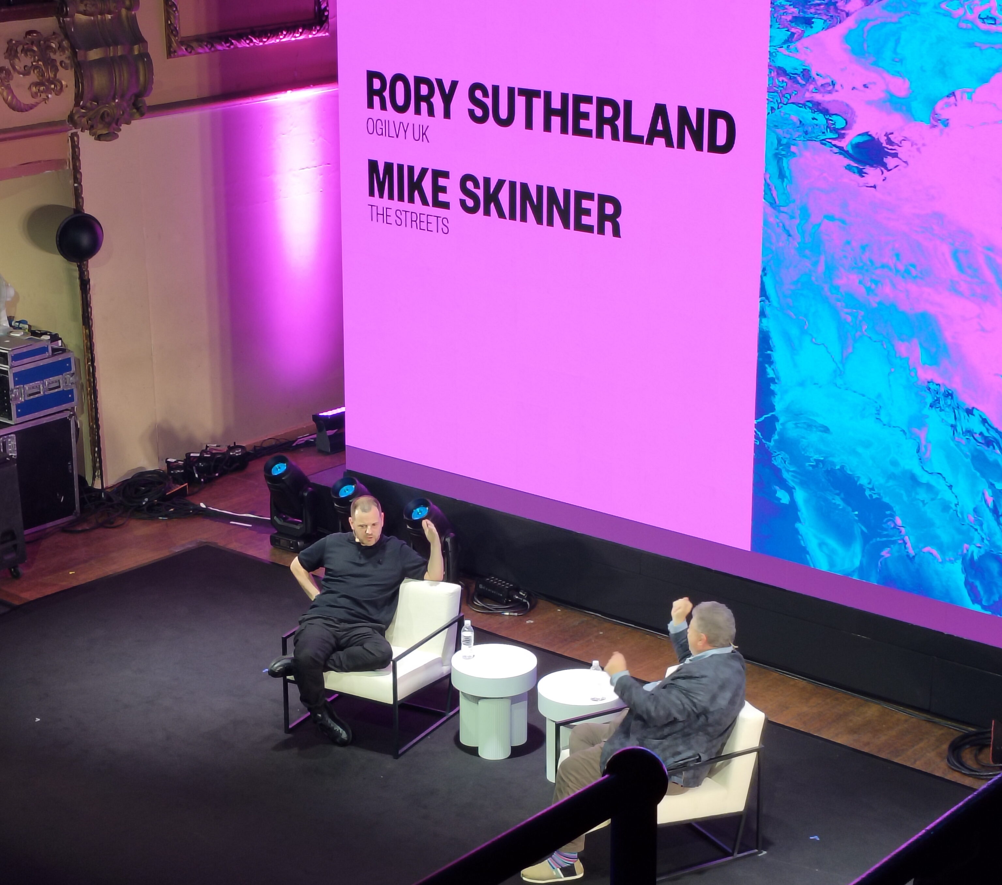
Mike Skinner (The Streets) and Rory Sutherland (Ogilvy) discuss the evolving nature of art and technology, particularly AI's impact on music. Skinner predicts a return to more human, imperfect music, influenced by past innovations like the electric guitar.
Sutherland highlights AI's unreliability and its potential to increase workload, citing an example of a football club's video editor creating 11 different edits. They also touch on the long-term effects of technology, the importance of reputation over short-term metrics, and the advantages of family-owned businesses in maintaining a long-term focus.
Skinner concludes by emphasizing the need for artists to trust their instincts and embrace uniqueness.
Session 4 Mike Skinner and Rory Sutherland in conversation

Slide 18
KEY LEARNINGS:
THE CROWD COMPLETES THE WORK
Art has two meanings: what you meant and what they see. Your job isn’t total control - it’s creating things that work for people.
USE AI TO AMPLIFY, NOT AMPUTATE
The real win is keeping the team and giving everyone AI to 10x their output, not firing 9 people and plugging in a chatbot.
THINK LIKE A FOUNDER, NOT A QUARTER
The best businesses behave like committed founders or families: they play the long game, not the next earnings call.
REPUTATION IS YOUR UNTAXED FORTUNE
You can’t tax reputation, but you can destroy it. Refuse to do “anything shit” and your future self (or kids) will thank you.
WEIRD BEATS AVERAGE
In a world of AI-generated “average,” the only safe place is distinctive - better to be a bold outlier than an optimized middle.
Session 4 Mike Skinner and Rory Sutherland in conversation

Slide 19
SESSION No.5
THE MEMENTO GENERATION - HOW TO CREATE VALUE WITH A NEW GENERATION OF SHOPPERS
Mary Portas, Jamie Laing, Snapchat and JD Sports

Slide 20
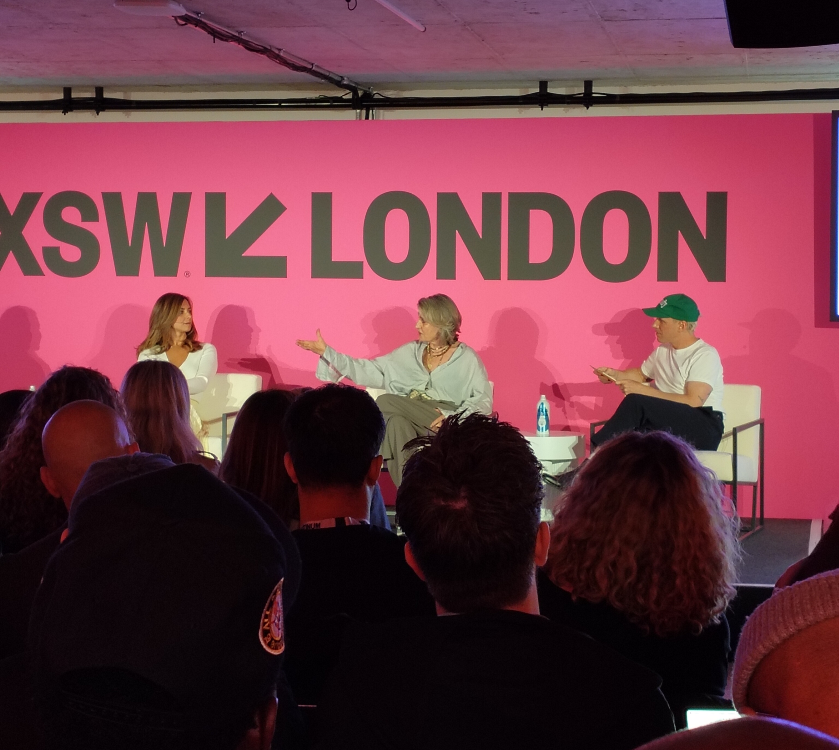
The discussion centred on the evolving consumer behaviour of younger generations, particularly Gen Z, and their shift from passive consumption to intentional memory-making. Key points included the cultural nostalgia for the 90s, the importance of physical and digital integration, and the need for brands to create meaningful experiences.
JD Sports highlighted their strategy of combining digital and physical retail to enhance customer engagement, while Snapchat emphasized its role in fostering meaningful connections and peer validation.
The conversation underscored the significance of creative risks, holistic brand experiences, and the value of physical spaces in building lasting consumer connections.
Session 5 The Memento Generation

Slide 21
KEY LEARNINGS:
FROM SCROLLING TO MEANING
Gen Z is burned out on passive scrolling; they still want speed, but only if the experience feels useful, meaningful, and in their inner circle.
MEMENTO GENERATION > MATERIAL GENERATION
Younger consumers value memories, moments, and connection over ownership; they want experiences they can live with friends and then share, not just more “stuff”.
DIGITAL + PHYSICAL MUST BE SEAMLESS, NOT SILOED
Consumers don’t think in “channels”. The brands that win (like JD x Snapchat) stitch online discovery, maps, chat, and in‑store experiences into one flow.
PHYSICAL SPACE IS A SUPERPOWER
Stores aren’t just distribution points; they’re meeting places. Retailers who make physical spaces social, joyful, and distinctive will win.
CREATIVE RISK BEATS OPERATIONAL OPTIMISATION
Years of chasing frictionless convenience made retail boring. Bold, creative, memory-making ideas, not just KPIs and ops, are now the differentiator.
Session 5 The Memento Generation

Slide 22
SESSION No.6
WHY CREATIVITY WILL SHAPE THE FUTURE OF BUSINESS
Sir John Hegarty

Slide 23
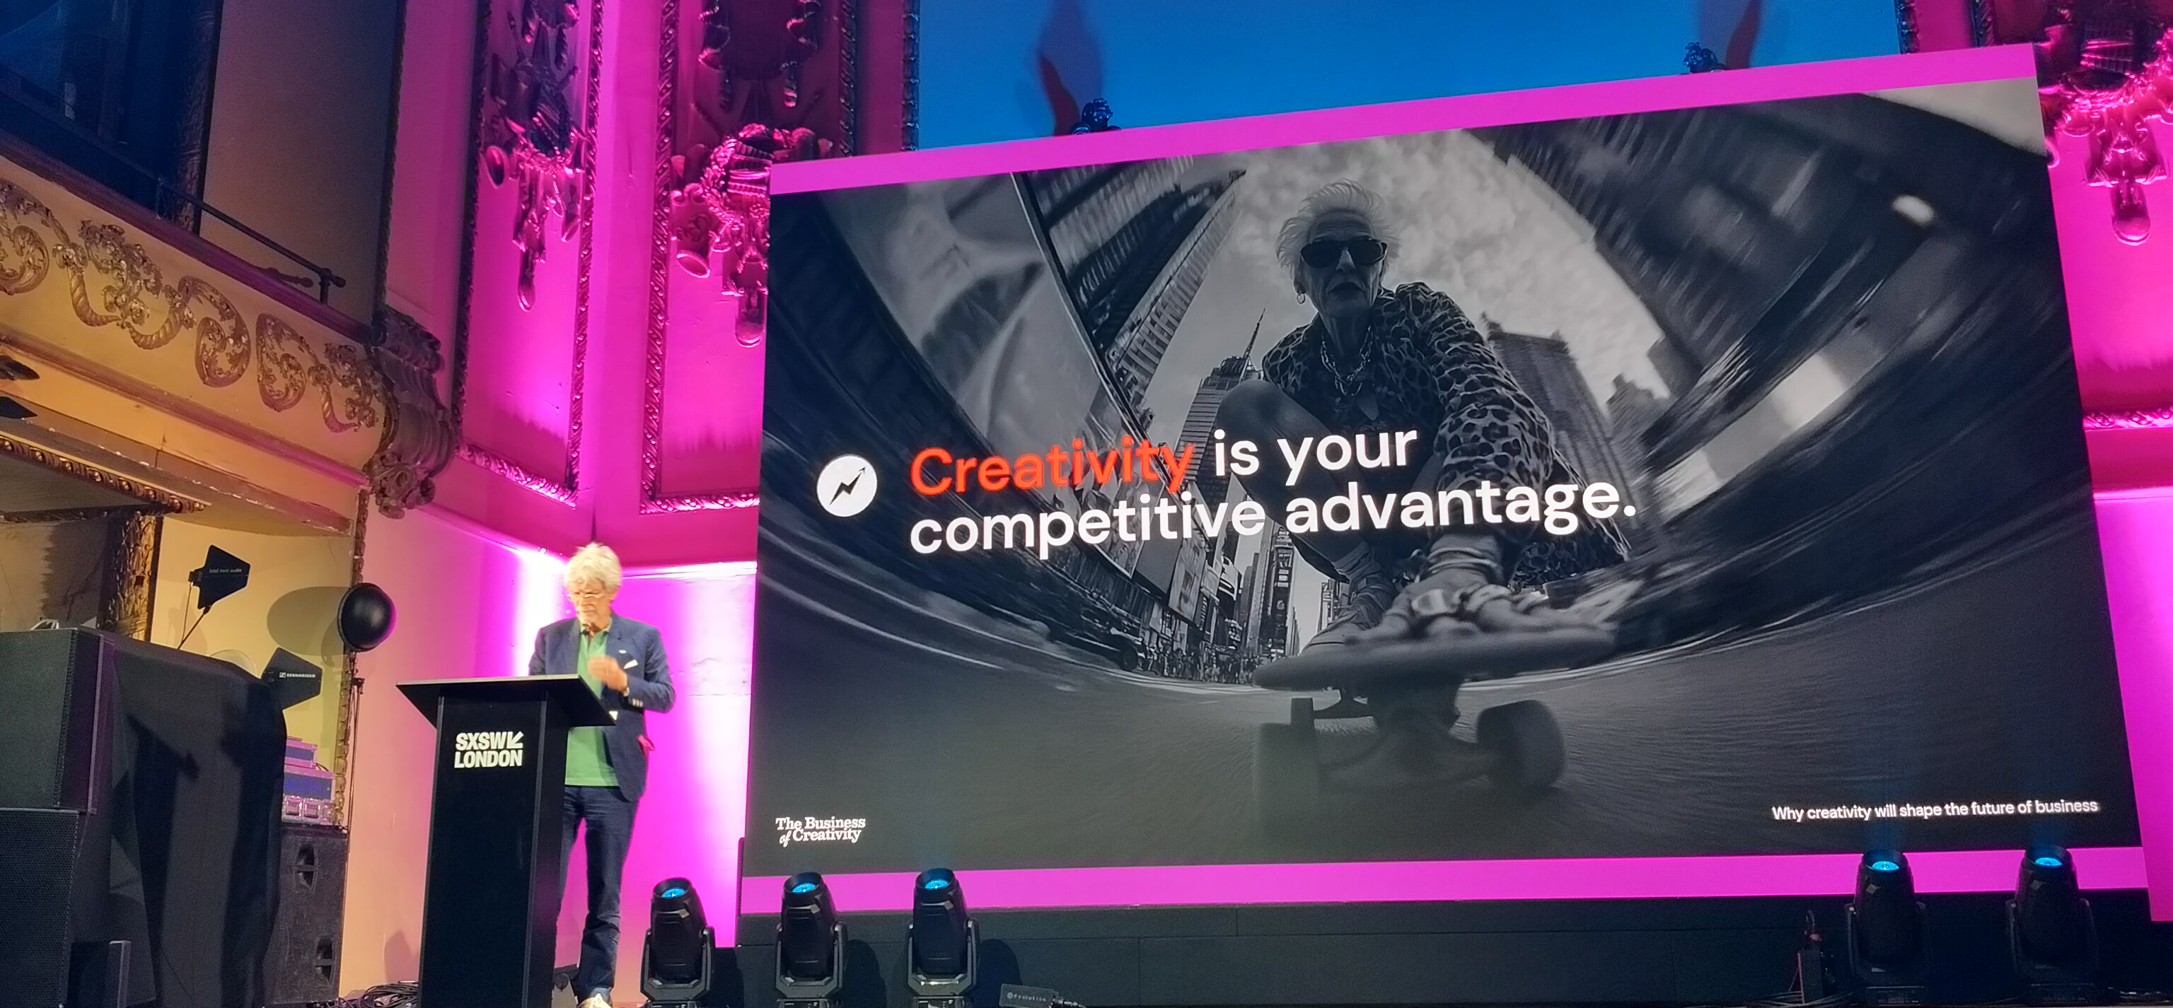
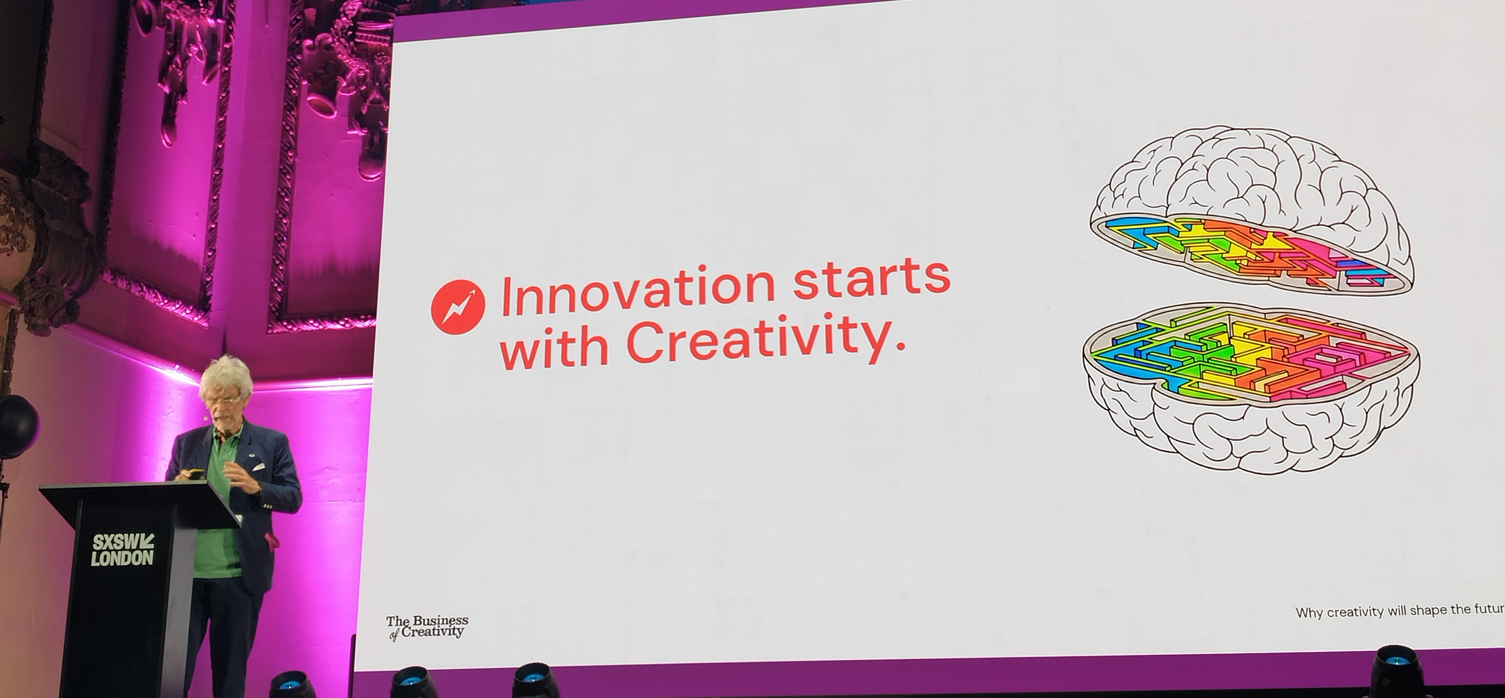
Sir John Hegarty argues that creativity is crucial for business success and economic growth, particularly as we transition from the digital age to the information age. He criticizes business schools for focusing on process over creativity, which he believes is essential for innovation.
Hegarty cites evidence from McKinsey showing that companies embracing creativity achieve higher returns and growth. He highlights successful entrepreneurs like Steve Jobs and Elon Musk, who didn't attend business school, and stresses the importance of structural change in companies to embed creativity.
He suggests that business schools should be replaced by art institutions to foster innovation and creativity.
Session 6 Why creativity will change the future of business

Slide 24
KEY LEARNINGS:
BUSINESS IS AN IDEA, NOT A PROCESS
Spreadsheets don’t create growth; ideas do. Process supports the business, but creativity defines it.
CREATIVITY IS THE ENGINE OF INNOVATION AND GROWTH
Companies that truly embrace creativity outperform on shareholder returns and organic growth- it’s a hard business driver, not a “nice to have.”
AI MAKES CREATIVITY NON‑NEGOTIABLE
AI democratises opportunity and collaborates with us, but human imagination and curiosity are its greatest asset. Scale alone is no longer an advantage.
CREATIVITY = EXPRESSION OF SELF
Real creativity comes from curiosity, diversity of thought, and putting your point of view into the world - not just mixing inputs in a clever way.
STRUCTURES MUST CHANGE, NOT JUST SLOGANS
To put creativity at the core, companies need structural change - upside‑down org charts, creative people empowered at the top, and leaders acting as Creative Executive Officers.
Session 6 Why creativity will change the future of business

Slide 25
SESSION No.7
FREEING BEN & JERRY'S - WHY OWNERSHIP MATTERS
Ben Cohen

Slide 26
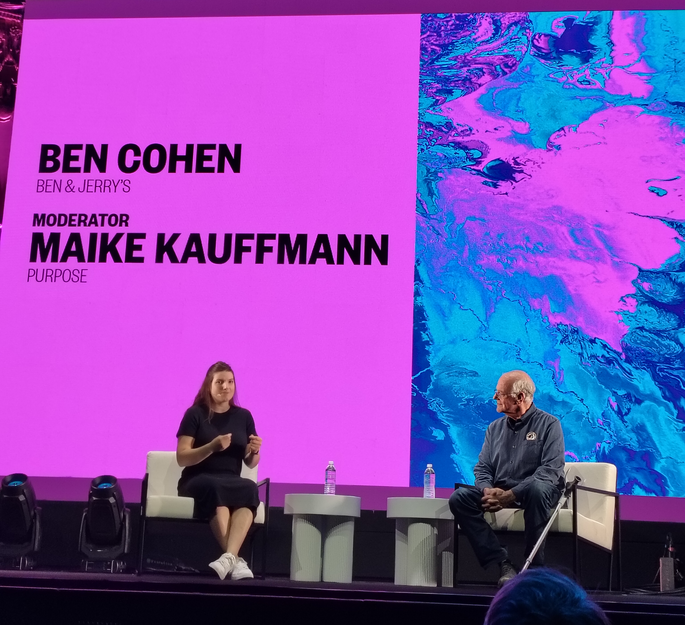
The discussion centred on Ben & Jerry's struggle to maintain its independence and social mission under Magnum Corporation's ownership.
The founder emphasized the importance of alternative ownership models like steward ownership, which separates economic rights from voting rights, ensuring the company remains mission-oriented.
They highlighted the need for businesses to address social issues and proposed the B Corporation structure as a legal framework.
The conversation also touched on the impact of Magnum Corporation's actions, the potential for a boycott, and the broader implications for business ethics and societal values.
Session 7 Freeing Ben & Jerry’s

Slide 27
KEY LEARNINGS:
BEN & JERRY’S “SOLD ITS SOUL” BY DESIGN FLAW, NOT INTENTION
Their original “super shares” safeguard was legally undone in the Unilever sale, showing how conventional corporate law can steamroll founders’ values.
MAGNUM’S OWNERSHIP IS ACTIVELY ERODING THE SOCIAL MISSION
The independent social-mission board is being dismantled, muting Ben & Jerry’s on issues like Trumpism and hollowing out the brand’s integrity.
STEWARD OWNERSHIP = MISSION OVER EXIT
By separating economic rights from voting control, steward ownership ensures profits serve the company’s purpose and prevents future mission‑killing sell‑offs.
IF YOU DON’T BAKE VALUES INTO THE LEGAL STRUCTURE, MONEY WINS
Even with a “dual mission,” profit pressure tends to dominate over time unless the social mission is locked into governance.
FOUNDERS MUST DESIGN OWNERSHIP ON DAY ONE
Once outside investors own too much, it’s often too late to pivot to purpose-first models; ownership choices at incorporation shape a company’s long-term soul.
Session 7 Freeing Ben & Jerry’s

Slide 28
SESSION No.8
CREATE LIKE A CREATOR: HOW CONTENT PRODUCTION IS CHANGING
Sam Thompson

Slide 29
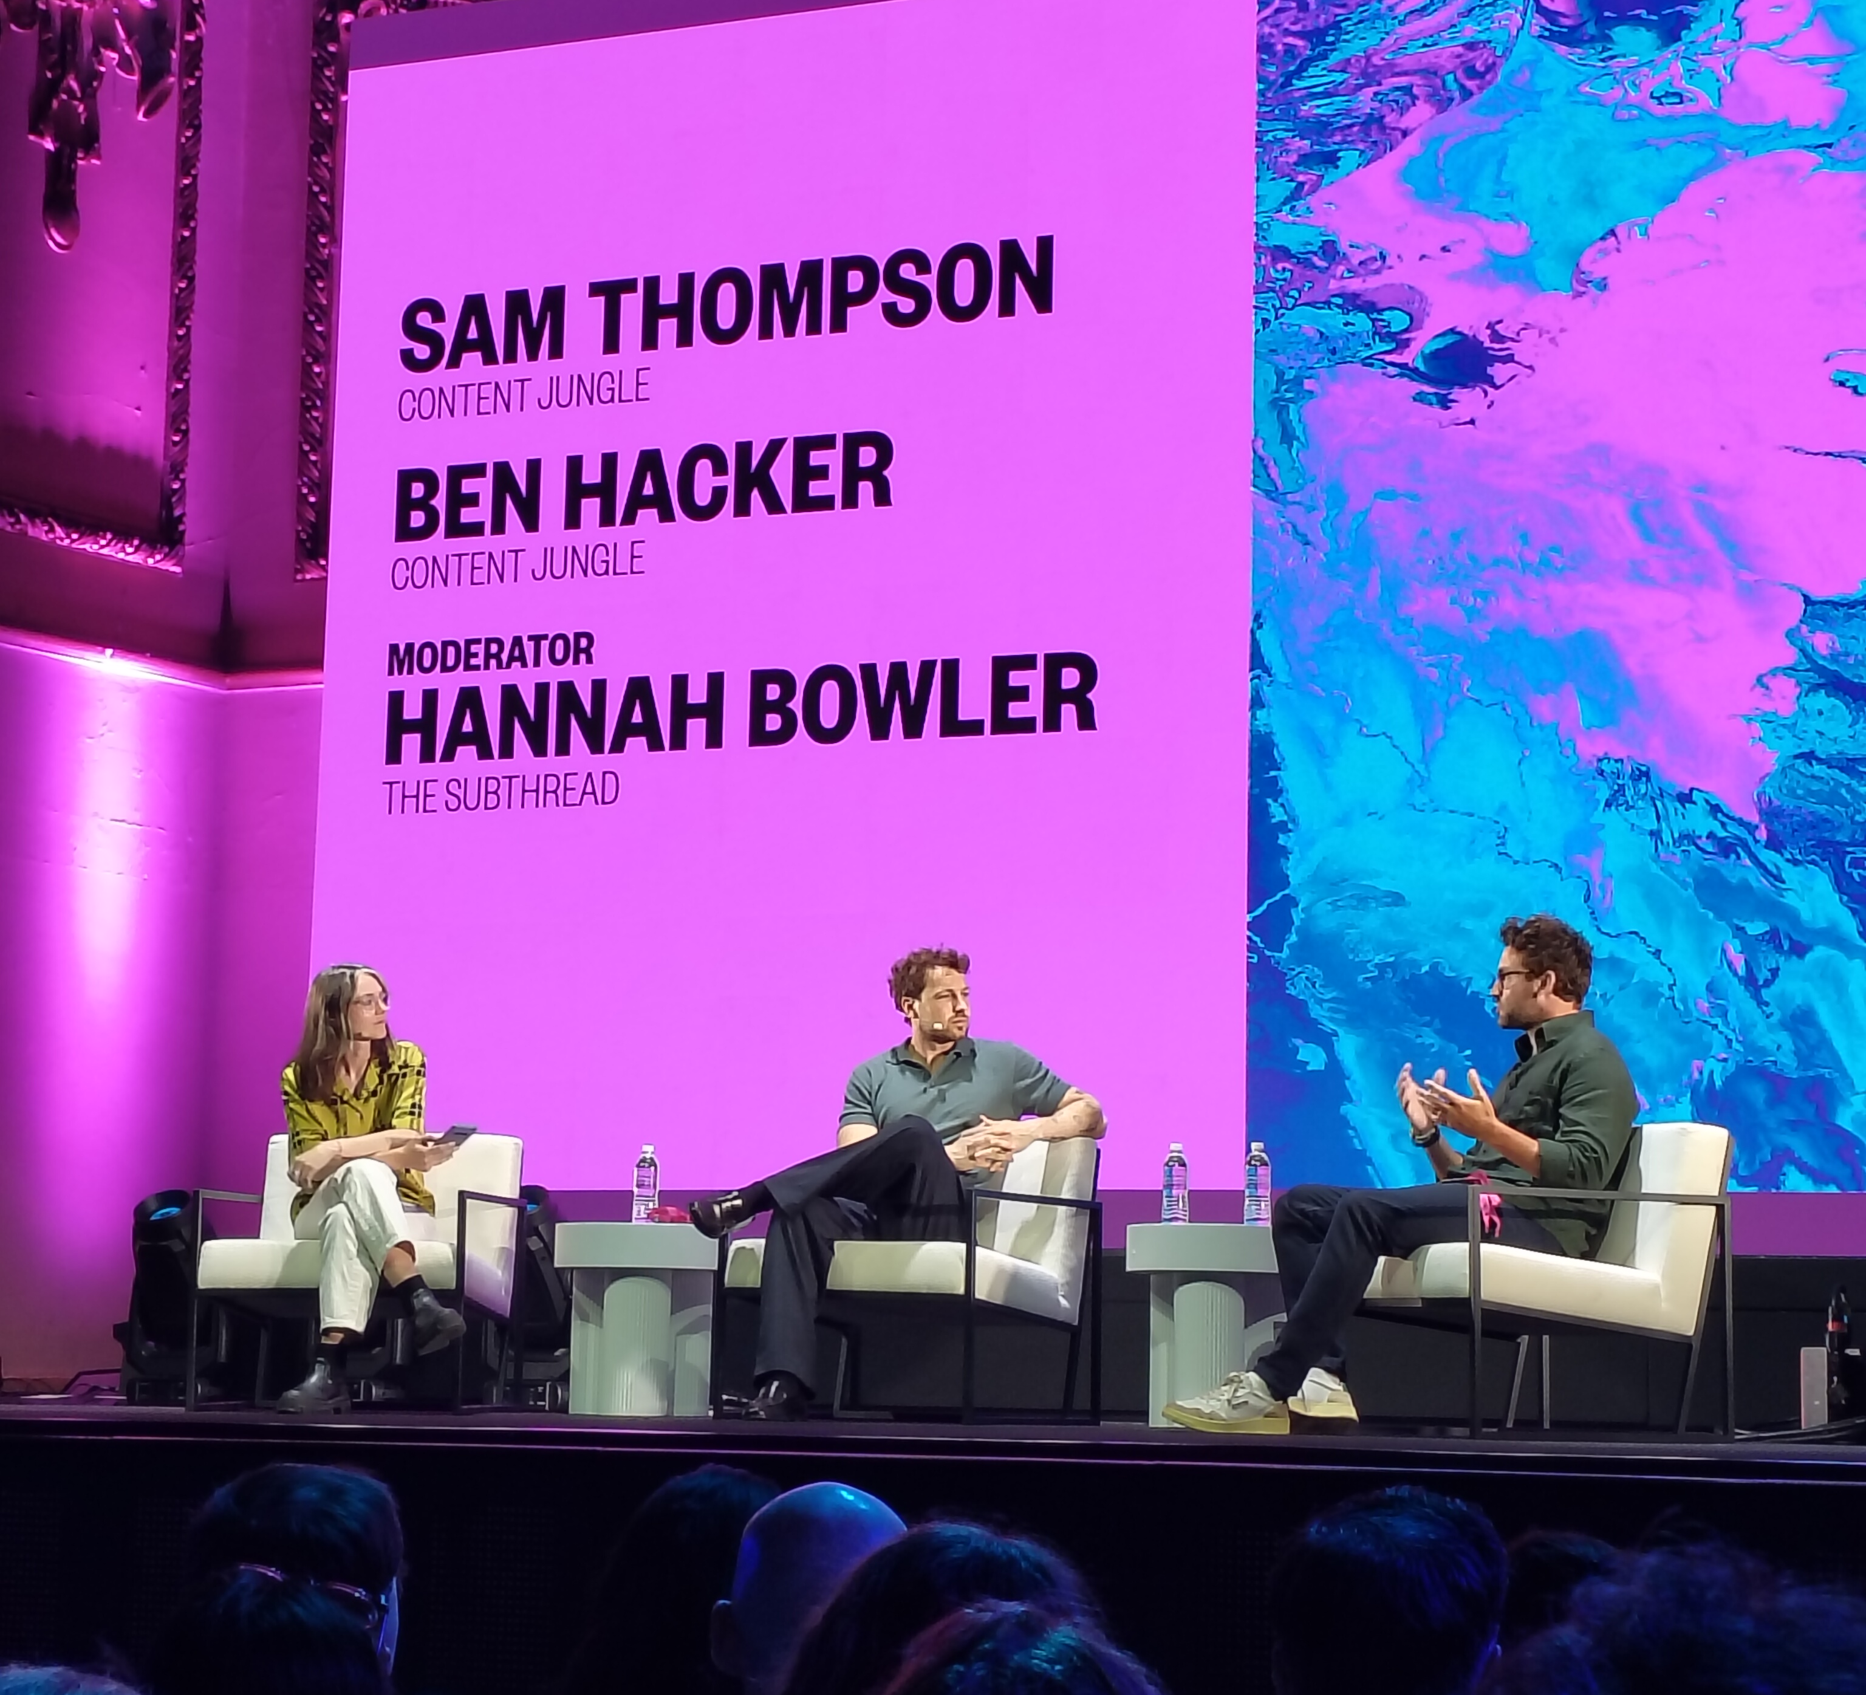
Sam Thompson and his team discussed the evolution of content creation, emphasizing the shift from traditional advertising to digital-first strategies. They highlighted the importance of creativity, flexibility, and trust in the creative process.
Sam shared his experience with a Cadbury campaign, where a low-budget, DIY approach outperformed a high-budget production. They also discussed the need for brands to trust creators and the potential of their platform, Content Jungle, to revolutionize the industry by providing a collaborative space for creators and brands.
The conversation underscored the importance of energy, trust, and adaptability in the creative economy.
Session 8 Create like a creator: How content production is changing

Slide 30
KEY LEARNINGS:
CREATOR > CREW
One sharp creator + a good videographer can outperform a £50k, overstaffed production any day.
TRUST THE CREATIVES
The best work happens when brands stop dictating every frame and let experts flex their instincts.
IDEA FIRST, FORMATS SECOND
Strong stories beat rigid deliverable checklists - great ideas adapt to any platform.
OLD ADS, NEW PLATFORMS
Mining classic TV commercials and remixing them for social is a creative gold mine.
CONTENT JUNGLE’S BIG BET
Build a tight, elite network of videographers, turn it into a production powerhouse, and make it the go-to infrastructure for the creator economy.
Session 8 Create like a creator: How content production is changing

Slide 31
SESSION No.9
WHAT HAPPENED TO GRASSROOTS CREATIVITY?
Sophie Booth, Brainlabs

Slide 32
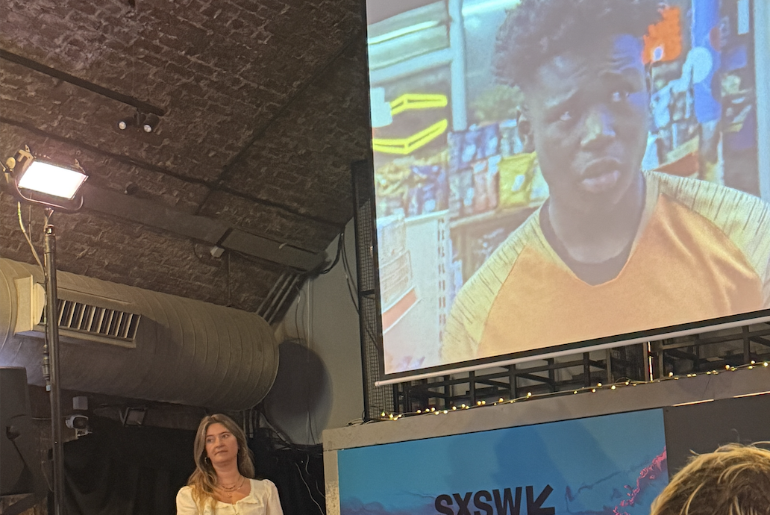
Sophie Booth explored how marketing has gradually shifted away from grassroots creativity towards what she described as the "Big Creative Era" dominated by celebrity partnerships and large-scale campaigns. Her argument was not that community-led marketing has become less effective, but that it has become harder to measure and therefore harder to justify in organisations increasingly focused on short-term performance metrics.
Using campaigns such as Nike's Nothing Beats a Londoner as examples, Booth argued that some of the most culturally influential campaigns are rooted in real communities, local insight and authentic participation. She also examined the rise of creator marketing, suggesting that creators initially succeeded because they offered both authenticity and measurable results.
However, she warned that as creators become more scripted and commercialised, the industry risks recreating the same problems that caused grassroots creativity to decline.
Session 9 What happened to grassroots creativity?

Slide 33
KEY LEARNINGS:
COMMUNITY STILL BEATS CELEBRITY
Grassroots marketing hasn't become less effective—it has become harder to measure.
PREDICTABILITY IS KILLING ORIGINALITY
Brands increasingly favour celebrity partnerships because they provide safer, more predictable outcomes.
CREATORS SUCCEEDED WHERE BRANDS STRUGGLED
Creator marketing combined community credibility with measurable performance.
OVER-MANAGING CREATORS DESTROYS VALUE
The more controlled creators become, the less authentic they feel.
CULTURE FIRST, CREATORS SECOND
Brands should start with communities and cultural insight before selecting talent.
Session 9 What happened to grassroots creativity?

Slide 34
SESSION No.10
BOSH: A CREATOR TAKEAWAY WITH BIG JOHN
Big John

Slide 35
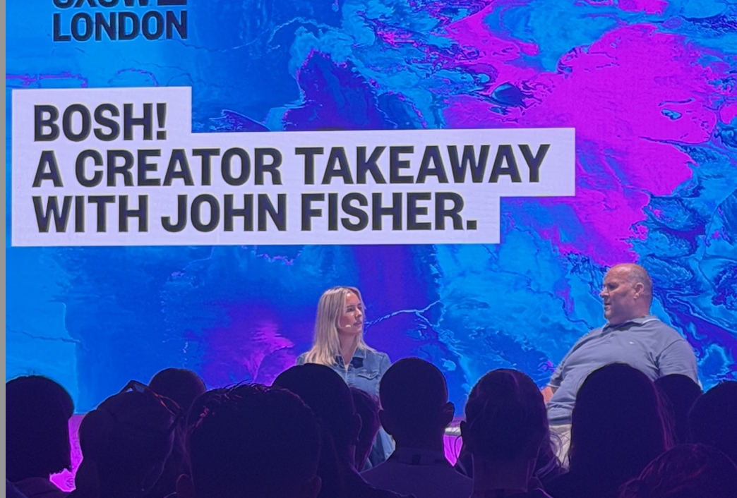
Big John shared the story behind his rise from posting everyday content about takeaways and daily life to becoming one of the UK's most recognisable social media personalities. Unlike many creator success stories, his growth was not built on sophisticated content strategies or high production values, but on consistency, relatability and genuine personality.
A recurring theme throughout the discussion was that audiences connect with creators because they feel familiar. Big John's community helped shape many aspects of his personal brand, including his famous catchphrases, demonstrating how creator identities are often co-created rather than carefully manufactured.
The session served as a reminder that authenticity remains one of the most powerful forces in modern content.
Session 10 Bosh: A creative takeaway with Big John

Slide 36
KEY LEARNINGS:
PEOPLE FOLLOW PEOPLE, NOT CONTENT
Relatability remains one of the strongest drivers of creator success.
COMMUNITIES BUILD CREATOR BRANDS
The most successful creator identities are shaped alongside audiences.
CONSISTENCY BEATS PERFECTION
Frequent, authentic content often outperforms heavily optimised strategies.
SIMPLE WINS
Personality and familiarity matter more than production value.
GROWTH CREATES AUTHENTICITY RISK
The challenge isn't becoming successful—it's staying believable afterwards.
Session 10 Bosh: A creative takeaway with Big John

Slide 37
SESSION No.11
SCALING YOUR SOCIALS & PERSONA BRAND
Chris Donnelly, Co-Founder of Searchable and “Global Top Voice on Linkedin”

Slide 38
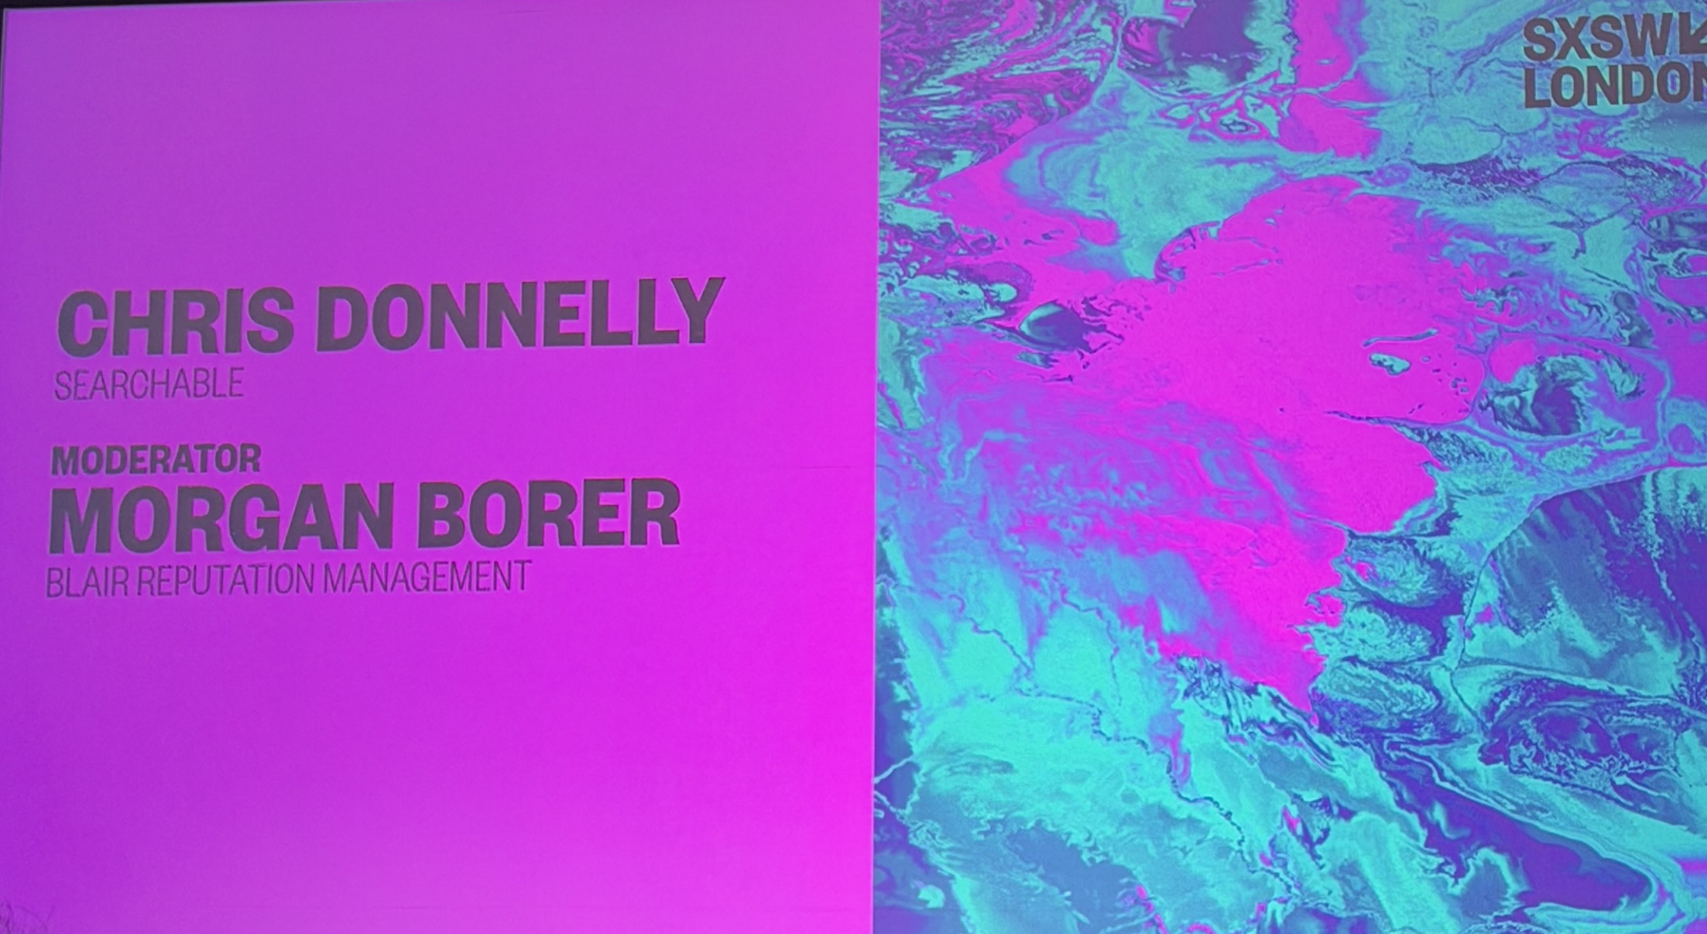
Chris Donnelly shared lessons from building multiple businesses alongside one of the UK's most influential founder-led personal brands. The discussion focused on how founders can use content and personal branding to create long-term business value rather than simply generating visibility.
A key theme was the distinction between fame and influence. Donnelly argued that audience relevance matters far more than audience size and that founders should focus on influencing the people most likely to become customers, partners or advocates.
The session also explored the rise of AI-powered search and the growing importance of Answer Engine Optimisation (AEO), highlighting how discoverability is changing in an AI-first world.
Session 11 Shaping your socials & persona brand

Slide 39
KEY LEARNINGS:
INFLUENCE MATTERS MORE THAN REACH
The right audience is more valuable than the biggest audience.
PERSONAL BRAND COMPOUNDS
Reputation continues generating value long after content is published.
EDUCATION REMAINS A GROWTH ENGINE
Useful content continues to outperform promotional content.
AI IS CHANGING DISCOVERY
Brands must increasingly optimise for AI-generated answers.
JUDGEMENT BECOMES THE DIFFERENTIATOR
Strategic thinking grows in value as AI creates more content.
Session 11 Shaping your socials & persona brand

Slide 40
SESSION No.12
CAN WE STILL SAVE THE INTERNET FOR KIDS?
Baroness Beeban Kidron

Slide 41

One of the most thought-provoking sessions of SXSW focused on the relationship between children, technology and the growing influence of AI. The speaker challenged the assumption that online safety is primarily a behavioural issue and argued instead that greater responsibility should sit with the platforms designing and monetising digital experiences.
The discussion explored how social media platforms are intentionally designed around engagement and examined growing political momentum behind potential under-16 social media restrictions. The conversation also expanded into AI governance, highlighting concerns around safety, accountability and regulation.
A recurring theme throughout was that digital wellbeing is becoming a societal issue rather than simply a technological one.
Session 12 Can we still have the internet for kids?

Slide 42
KEY LEARNINGS:
THE PROBLEM ISN'T JUST CHILDREN - IT'S PLATFORMS
Responsibility is increasingly shifting towards technology companies.
ATTENTION REMAINS THE BUSINESS MODEL
Endless engagement is a feature, not a flaw.
PARENTS ARE PART OF THE CHALLENGE
Adult technology habits significantly influence children's wellbeing.
UNDER-16 RESTRICTIONS APPEAR INCREASINGLY LIKELY
Brands should prepare for greater regulation of youth audiences.
DIGITAL RESPONSIBILITY IS BECOMING A BRAND ISSUE
Consumers increasingly expect safer, more responsible digital environments.
Session 12 Can we still have the internet for kids?

Slide 43
SESSION No.13
WHY WE NEED IMMIGRANTS
Neri Kara Silliman (University of Oxford), Mursal Hedayat (Chatterbox) & moderator Rita McGrath (Columbia University)

Slide 44
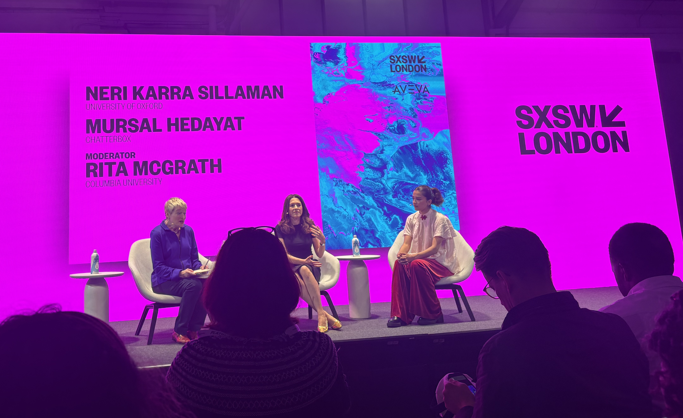
This discussion explored the role immigrants play in driving entrepreneurship, innovation and economic growth.
Drawing on research and real-world examples, the panel challenged narratives that frame immigration as a burden and instead highlighted its contribution to business creation, talent development and societal progress.
Beyond the statistics, the conversation focused on why immigrants often become effective innovators. Navigating uncertainty, rebuilding networks and adapting to new environments develops resilience, creativity and problem-solving skills that are increasingly valuable in modern organisations.
The panel also highlighted the importance of community, purpose and diversity as drivers of long-term success.
Session 13 Why we need immigrants

Slide 45
KEY LEARNINGS:
DIVERSITY DRIVES INNOVATION
Different perspectives create better solutions and stronger businesses.
RESILIENCE CREATES ENTREPRENEURS
Navigating uncertainty builds highly transferable skills.
PURPOSE AND PROFIT CAN COEXIST
Many successful businesses begin by solving meaningful problems.
COMMUNITY IS A GROWTH STRATEGY
Strong networks create sustainable competitive advantage.
TALENT IS EVERYWHERE
The opportunity lies in recognising and unlocking untapped potential.
Session 13 Why we need immigrants

Slide 46
SESSION No.14
HUMAN AI STRATEGY: FROM ADOPTION TO ORGANISATIONAL ADVANTAGE
Dr Laura Weiss at WPP

Slide 47
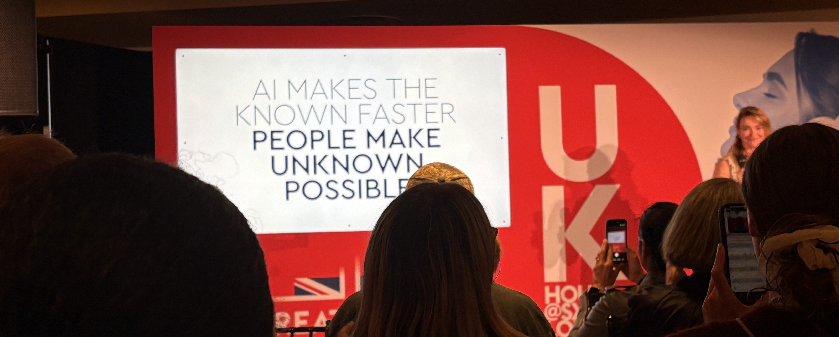
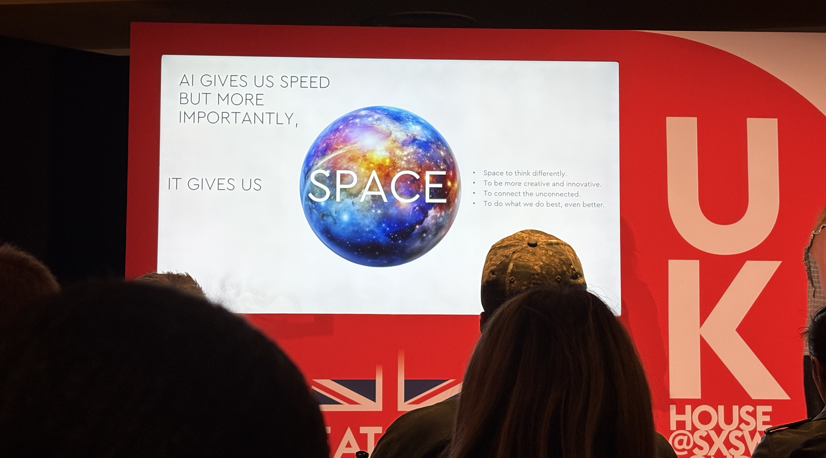
Dr Laura Weiss explored how organisations can move beyond AI adoption and towards genuine organisational transformation. Drawing on expertise in psychology, workforce analytics and AI strategy, she argued that the greatest challenge is not technology itself, but how effectively organisations bring together people, processes and AI systems.
A central theme was that AI acts as an amplifier rather than a solution. In high-performing organisations it can accelerate success, while in dysfunctional environments it often magnifies existing problems. Weiss also explored how AI is reshaping work, talent development and organisational design, highlighting the growing importance of connection, collaboration and strategic thinking.
Session 14 Human AI strategy

Slide 48
KEY LEARNINGS:
AI AMPLIFIES - IT DOESN'T FIX
Technology strengthens existing organisational strengths and weaknesses.
PEOPLE, PROCESS AND AI MUST WORK TOGETHER
Sustainable value comes from the system, not the tool.
EFFICIENCY ISN'T THE END GOAL
The opportunity lies in how organisations use the time AI creates.
CONNECTORS WILL BECOME INVALUABLE
Future advantage comes from linking ideas, disciplines and technologies.
HUMAN SKILLS BECOME MORE IMPORTANT
Creativity, judgement and collaboration increase in value as AI adoption grows.
Session 14 Human AI strategy

Slide 49
SESSION No.15
THE COMPANY YOU PITCHED ISNT THE COMPANY THAT THRIVES
Saman Darkan, Co-Founder & Chief Technology/Product Officer of Kitopi

Slide 50
Saman Darkan shared the story of how Kitopi evolved from a cloud-kitchen startup into a broader technology-enabled hospitality platform.
Through examples from product development, marketing, AI adoption and business strategy, he demonstrated how successful companies evolve by following customer behaviour rather than remaining attached to their original vision.
A recurring theme was adaptability. Darkan argued that growth requires leaders to remain objective, challenge assumptions and continuously reinvent aspects of their business model. While technology and AI play an important role, the session reinforced that customer understanding remains the most important driver of long-term success.
Session 15 The company you pitch isn’t the company that thrives

Slide 51
KEY LEARNINGS:
DATA SHOULD CHALLENGE ASSUMPTIONS
Strong evidence creates confidence for strategic change.
FOLLOW CUSTOMERS, NOT YOUR
BUSINESS PLAN
Growth comes from adapting to customer behaviour.
PHYSICAL AND DIGITAL WORK BEST TOGETHER
Customers value integrated experiences, not channels.
AI CREATES LEVERAGE, NOT STRATEGY
Technology accelerates execution but doesn't replace insight.
ADAPTABILITY IS A COMPETITIVE ADVANTAGE
The businesses that thrive are willing to reinvent themselves.
Session 15 The company you pitch isn’t the company that thrives

Slide 52
SESSION No.16
STAY LOUD, STAY WELL
With iconic artist and advocate Mel B in conversation with Zumba CMO Carolina Moraes

Slide 53
This discussion explored how mental and physical health drive collective empowerment. Mel B, who recently completed a trauma-informed care course at Leeds Beckett University, shared her personal journey of resilience and her coping strategies for reclaiming mental health and happiness in her own life.
Alongside her, the Zumba CMO Carolina Moraes explored how the global fitness movement goes far beyond physical exercise, directly impacting mental wellbeing.
The session was moderated by the writer Louise Gannon.
Session 16 Stay loud, stay well

Slide 54
KEY LEARNINGS:
HEALING STARTS WITH OWNING YOUR STORY
Personal resilience begins with acknowledging past trauma rather than avoiding it.
MENTAL AND PHYSICAL HEALTH ARE DEEPLY CONNECTED
Mental and physical wellbeing are not separate goals - they reinforce each other.
COMMUNITY CREATES COLLECTIVE STRENGTH
Empowerment is amplified when people come together around shared experiences and healthy habits.
CONSISTENT COPING STRATEGIES MATTER MORE THAN QUICK FIXES
Long-term wellbeing is built through sustainable practices and coping mechanisms
WELLNESS IS POWER
People are better equipped to thrive and contribute when they feel mentally and physically well
Session 16 Stay loud, stay well

Slide 55
SESSION No.17
BEYOND PODCASTING: BUILDING SHOWS PEOPLE BELONG TO
With Dino Sofos (CEO of Persephonica), Miquita Oliver (the host of their hit show, ‘Miss Me?’), along with Jamie Laing and Craig Strachan from Jampot

Slide 56
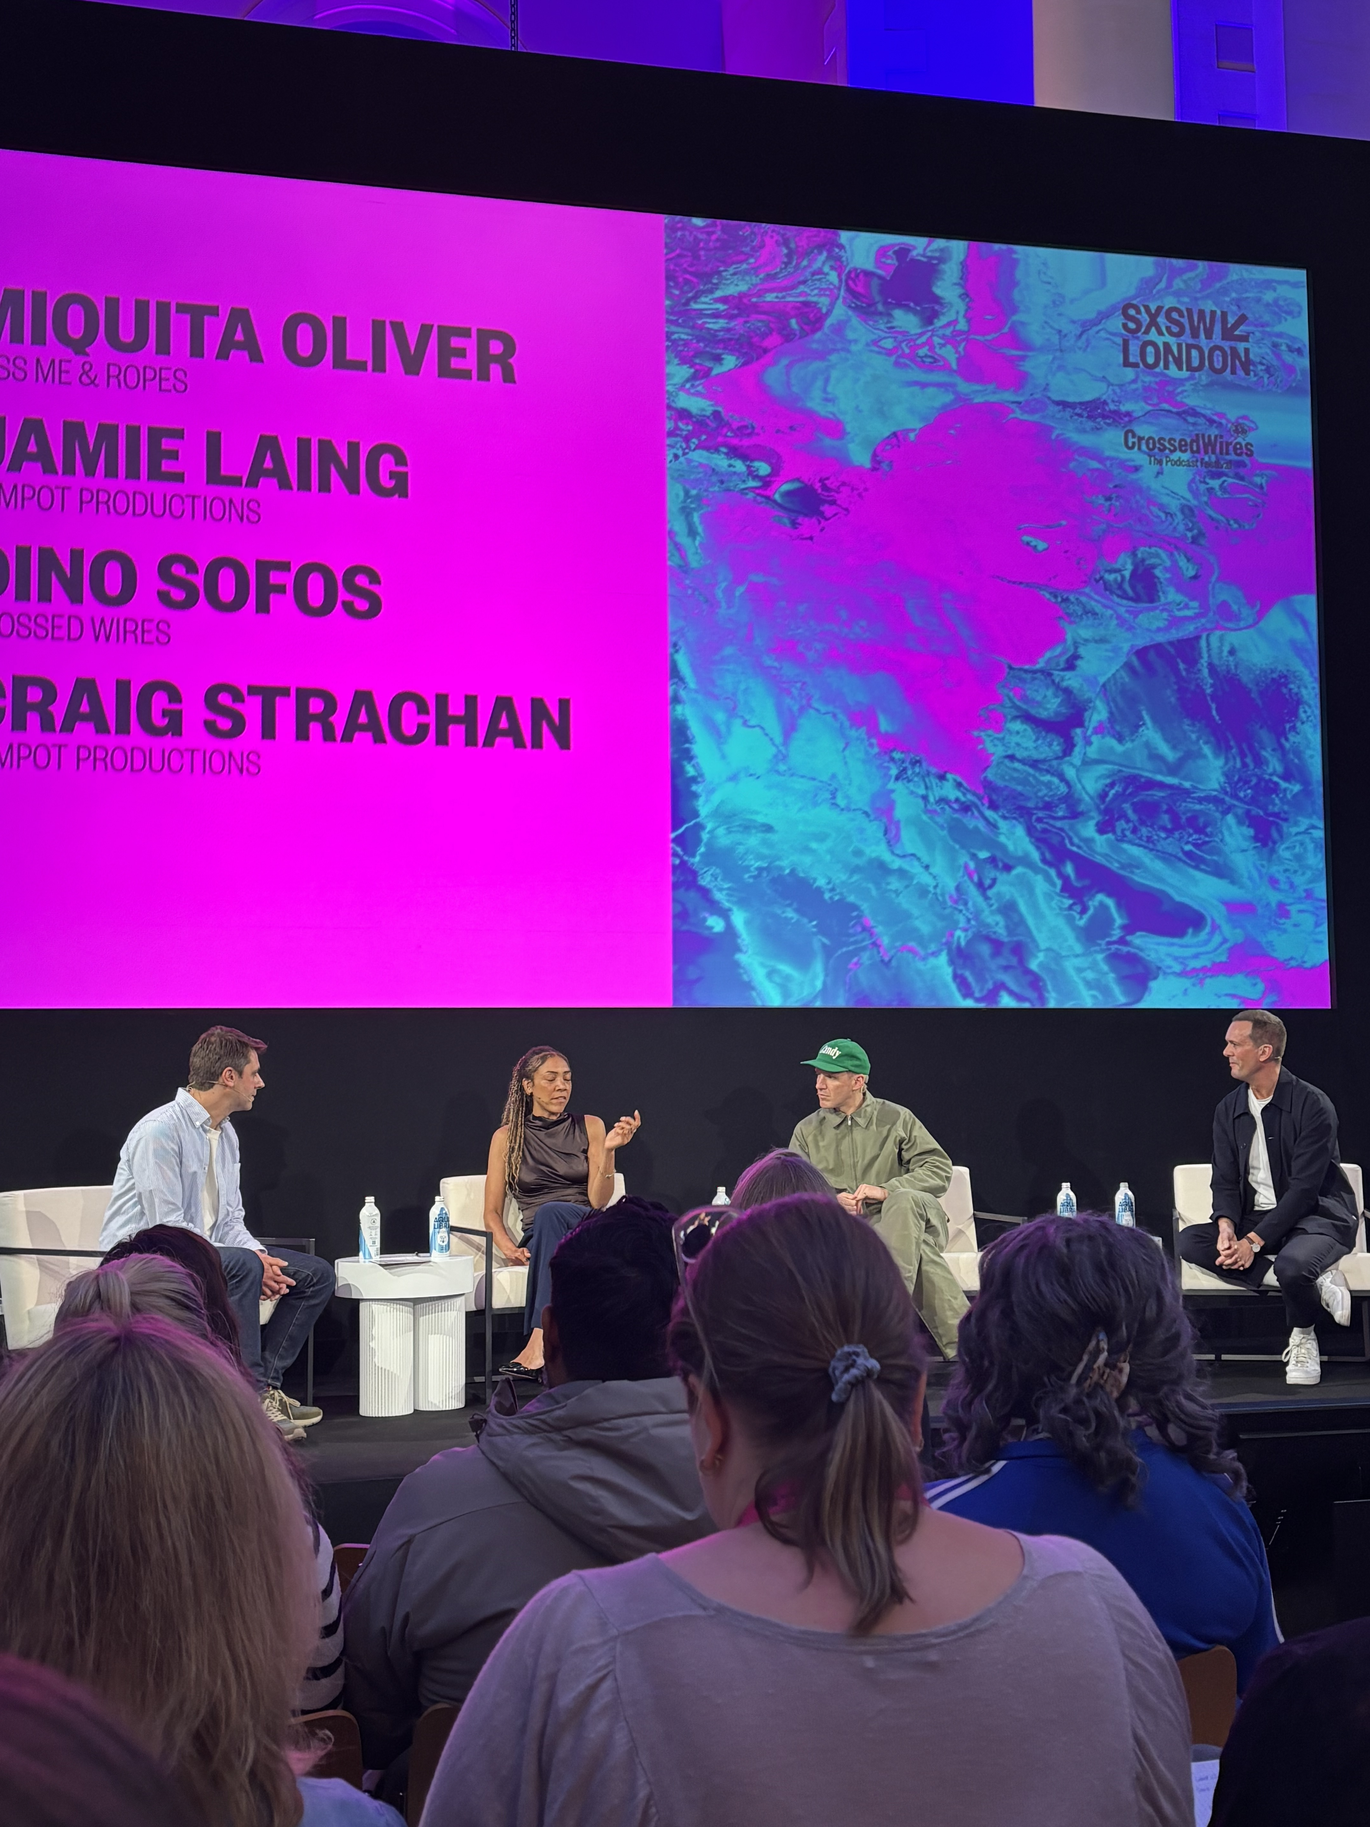
This session was about how the definition of a podcast is changing. The most successful shows today aren’t just audio products - they’re 360 brands with communities and ongoing conversations that live across multiple platforms.
Dino Sofos, the CEO of Persephonica, was joined by Miquita Oliver, the host of their hit show, ‘Miss Me?’, along with Jamie Laing and Craig Strachan from production company Jampot.
They spoke about how podcasting is being rebuilt around personality, fandom and shareability. From formats engineered for TikTok and YouTube, to the rise of video-first podcasting, to building listener communities that feel closer and more engaged than traditional media ever allowed, the panel unpacked what actually makes shows cut through in 2026.
Session 17 Beyond podcasting: Building shows people belong to

Slide 57
KEY LEARNINGS:
CONTENT MUST BE DESIGNED FOR SHAREABILITY
Podcast formats are increasingly being engineered for platforms like TikTok and YouTube, where discovery is driven by short-form, highly shareable moments.
PERSONALITY IS THE NEW COMPETITIVE ADVANTAGE
In the creator era, audiences are drawn to authentic personalities and distinctive voices. Talent is becoming as important as the content itself, with fandom often driving growth more than production value.
AUDIENCE INTIMACY IS A POWERFUL GROWTH ASSET
Podcasting's unique strength lies in the close relationships hosts build with their audiences. This sense of intimacy creates trust, loyalty, and influence that traditional media often struggles to replicate.
PODCASTS ARE BECOMING MULTI-PLATFORM BRANDS
The most successful podcasts are now 360° media brands that extend across video, social content, live experiences, and community engagement.
COMMUNITY IS MORE VALUABLE THAN REACH
The strongest shows create a sense of belonging, not just listenership. Audiences want to feel like participants rather than passive consumers.
Session 17 Beyond podcasting: Building shows people belong to

Slide 58
SESSION No.18
BEYOND PODCASTING: HEALING ARTS / ART AS CURE?

Slide 59
This panel explored the intersection of rigorous science and artistic intuition to ask whether arts should be prescribed as fundamental health behaviour and essential societal infrastructure.
The discussion featured Professor Daisy Fancourt (UCL) and artist Lakwena Maciver, with curation by Cedar Lewisohn of the Southbank Centre.
Session 18 Beyond podcasting: Healing Arts / Art as cure?

Slide 60
KEY LEARNINGS:
THE ARTS DELIVER MEASURABLE HEALTH BENEFITS
Emerging research shows that engaging with the arts can have tangible biological effects, including reducing depression, improving immune function, slowing aspects of aging, and even influencing gene expression.
CREATIVITY CAN BE AS ESSENTIAL AS EXERCISE
Making or experiencing art functions similarly to other preventive health behaviours
THE FUTURE OF HEALTHCARE MAY INCLUDE CREATIVE PRESCRIPTIONS
The concept of social prescribing is gaining momentum, with healthcare providers increasingly exploring activities such as museum visits, creative workshops, and artistic participation as part of treatment and prevention plans.
ACCESS TO THE ARTS IS A PUBLIC HEALTH ISSUE
The arts are often treated as a luxury rather than an essential service, creating barriers for many communities who could benefit.
SCIENCE AND CREATIVITY ARE STRONGER TOGETHER
While health outcomes are often measured through data and clinical evidence, artists bring human insight, emotion, and intuition that can improve how healthcare experiences are designed and delivered.
Session 18 Beyond podcasting: Healing Arts / Art as cure?

Slide 61


